Slide 1
Advancing Research, Creativity, and Innovation at UConn
Annual Report on Research
Radenka Maric, PhD
Vice President for Research,
Innovation and Entrepreneurship
UConn/UConn Health
University Senate Meeting
March 2, 2020

Slide 2
VISION
Leverage research capacity to support faculty, increase expenditures, and contribute to the state economy. To be recognized as a leading research institution in the US and nationally.
Research growth through grants & philanthropy
Large-scale, interdisciplinary proposals
Partnerships that support industry
Boost UConn’s national & international reputation/impact
Tech transfer growth
Increase scalable startups
Philanthropic initiatives
Position UConn as an economic engine for the state

Slide 3
GOALS & PRIORITIES
Efficiency, open door policy, transparency
Integration between Storrs and UConn Health
Non-traditional extramural funding
Recognition and incentives for research, creativity, innovation, and scholarship success
Engagement with internal and external stakeholders

Slide 4
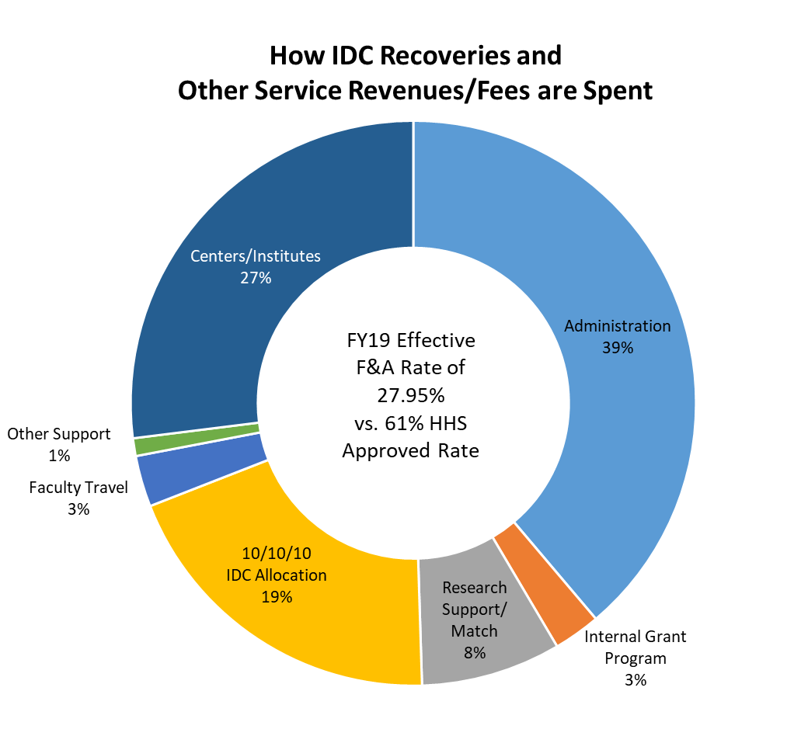
FY2019 ovpr budget
Revenue Sources Include:
IDC Recoveries
Animal Care Per Diems
TIP Rental Income
TCS Royalties
Research Core Services

Slide 5
Research Funding at UConn
UConn Sponsored Program Activity | FY19
Annual Grant Expenditures | $157M
Proposals | $738M
Grants Awarded | $164M
Average Grant Award Size | $312K
UConn Health Sponsored Program Activity | FY19
Annual Grant Expenditures | $87M
Proposals | $516M
Grants Awarded | $102M
Average Grant Award Size | $554K

Slide 6
Sponsored Program Activity, FY2007-FY2019

Slide 7
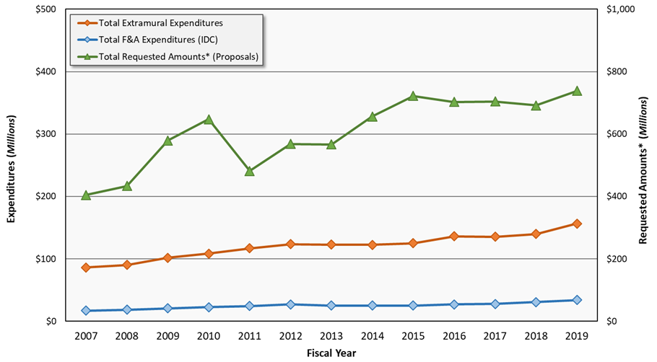
UConn Storrs Sponsored Program Activity, FY2007-FY2019

Slide 8
UConn Health Sponsored Program Activity, FY2007-FY2019

Slide 9
Where We Are
Tech Commercialization
74 out of 225 institutions
In line with peers and icons
Underperform in licensing revenue
Driver of innovation ecosystem
Increasing expectations for growth and outcomes

Slide 10
Where We’re Headed
Innovation & Entrepreneurship
University-wide culture and mission
Practices and policies aligned with icons
All schools and colleges represented
Resources aimed at gaps in the system
Increase startups in CT economy
Increase tech transfer revenue
Informed by 2018-19 Best Practice Review

Slide 11
Challenges
Fringe rates
Recruitment of top faculty
Investment in existing people & infrastructure
Late proposal submission to SPS
One UConn
Separate enterprise-wide systems at UConn and UConn Health

Slide 12
Opportunities
Balancing Growth Strategy with Effective Operational Management
Strategic:
Identify and intensify specific research strengths
Aggressively promote the public impact of UConn research
Compete for bigger bet opportunities
Maintain and grow industry and philanthropic partnerships
Align hiring with research growth strategy
Proactively court non-federal funders
Operational:
Efficiency, effectiveness, accountability and quality
Support and serve faculty effectively on administrative needs and career development
Communicate and advocate for value of university research
Continue to nurture faculty and student talent by supporting seed initiatives
Data tracking to measure progress and impact and to guide investments
Ensure compliance and mitigation of risk

Slide 13
Thank You
radenka.maric@uconn.edu
michelle.williams@uconn.edu
ovpr.uconn.edu

