Slide 1
Board of Trustees
9/30/2020
FY21 Budget Update
UConn and UConn Health

Slide 2
UConn
Storrs and Regional Campuses

Slide 3
Overview
Source of fiscal challenge is shifting from lost housing revenues to mounting student support and financial aid costs. Unfunded legacy costs remain.
Before the pandemic, UConn generated operating surpluses before covering unfunded legacy costs.
  High legacy costs ($31M in FY21) are an ongoing problem that impacts our research and clinical competitiveness
Since the pandemic, UConn took aggressive steps to keep our students, faculty, and staff safe from the virus while continuing to deliver high quality education and research.
  Research activities restarted under strict safety protocols; usage of classrooms and residential halls down to 40% of capacity
Newest challenge is the increasing need for student safety and financial aid.

Slide 4
Impact of Unfunded Legacy and COVID Costs
Annual budget cuts of $22-28m continue to be required to address $30-38m in unfunded legacy costs. COVID impacts compound losses in FY20 and FY21, requiring aggressive mitigation efforts and labor and/or state assistance.

Slide 5
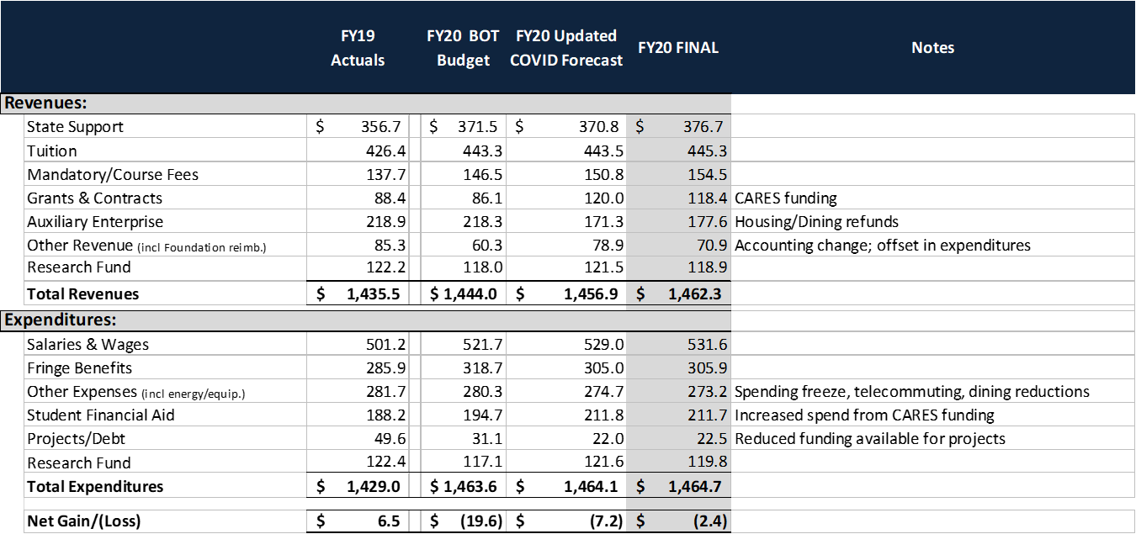
FY20 Update
In FY20 UConn was able to cover the $33.6M in refunds with federal CARES Act funding and departmental spending savings attributed to the spending freeze.

Slide 6
FY21 Projected Deficit
Initial deficit scenarios ranged from $47m to $129m (Apr)
Factors that improved fiscal situation
  Strong demand by degree-seeking students
  Strategies to recruit more out-of-state students and contract with universities overseas to keep our international students
Factors that hurt fiscal situation
  Continuation of pandemic will affect spring semester
  Decision to reduce capacity to 40% was necessary for safety reasons
Current deficit estimate is now $76M (Sep)
  If we are forced to close campus early, deficit estimate rises to $109M.

Slide 7
10th Day Enrollment Census
Initial projected enrollment declines due to COVID: in-state students (-5%), out-of-state (-7%), and international students (-40%).
Enrollment Management and Global Affairs developed strategies to mitigate enrollment losses of out-of-state and international students.
Actual enrollment: in-state students (+2%), out-of-state (+5%), and international students (-4%).

Slide 8
Change in FY21 COVID Fiscal Impact Estimates
Current estimate made based on 10th day Census. June estimate made under extreme uncertainty.
Impacted FY21 Revenues & Expenses ($M) | Current Estimate
 | June BOT (mid case) | Current | Notes
Tuition revenue | (24.4) | 6.6 | Growth in in-state and domestic out-of-state students offset losses in international students
Net housing, dining & fee revenue | (33.4) | (67.0) | Assumed 70% capacity in June; Dropped to 39% by Sept.
Financial aid expenses | - | (7.4) | Increase in need-based aid
Net other expenses | - | (0.7) | Additional expenses offset by savings
COVID impact | (57.8) | (68.5)
Original Pre-COVID deficit | (7.0) | (7.0)
Total Impact | (64.8) | (75.5)

Slide 9
FY21 Budget Tracker – Current Case
Of a $76M projected deficit, $35M in mitigation has been realized and $13M will be realized throughout the year, leaving a $28M deficit yet to address.
If this were to include the State unfunded legacy costs at $30.9M, the request would total $59M.

Slide 10
Deficit Mitigation w/Early Close Scenario
Deficit mitigation estimate is $109M if we are forced to close early, and rises by $2m for each week we close before Nov 1.
If this were to include the State unfunded legacy costs at $30.9M, the request would total $59M in the current case and $89M with an early closure.

Slide 11
FY21 Detail
With current mitigation plan and 10th day updates, the current deficit is $28M.
$50M got moved from net revenue (auxiliary/fees/other) to expense savings (other expenses).

Slide 12
Allocating COVID Cuts
We are preparing to implement $28M in additional cuts
  Send out budget call with flexible guiding rules on how to meet targets
  VP/AVPs & Deans respond with plans on how they would meet targets
  Leadership decides course of action
($ millions) | Cuts Implemented | Additional Cuts Planned for Implementation* | Total Cuts
Academics | 2 | 17 | 19
Administration | 9 | 10 | 19
Athletics | 2 | 1 | 3
Total Cuts | 13 | 28 | 41
* When $13m cuts were executed, we asked all units to plan for additional cuts.

Slide 13
Biennium Request
The first phase of the biennium request, submitted 9/1, included only limited technical adjustments.
Second phase of the biennium request, to submit on 10/2, includes request for $28M as a one-year COVID bridge and seeking relief from 10% reduction in state block grant.

Slide 14
Ongoing Risks
Major risks include continuation of pandemic, lack of government support, and large and increasing fringe costs.
Enrollment
Normal risk of Spring melt
COVID
Potential for another outbreak in Fall or Spring
Economic hardship of students/families putting pressure on financial aid budget
State Support
10% decrease in annual appropriation would cost $39.7M ($21m plus fringe), lowering state support per CT student from $11,000 to $9,000
Fringe Costs
Fringe benefit rates—over which UConn has no control—continue to rise, and UConn must cover these costs with non-state funds

Slide 15
UConn Health
Fiscal Year 2020
Update

Slide 16
FY 2020 Year-End
(Unaudited)

Slide 17
UConn Health
Fiscal Year 2021
Update

Slide 18
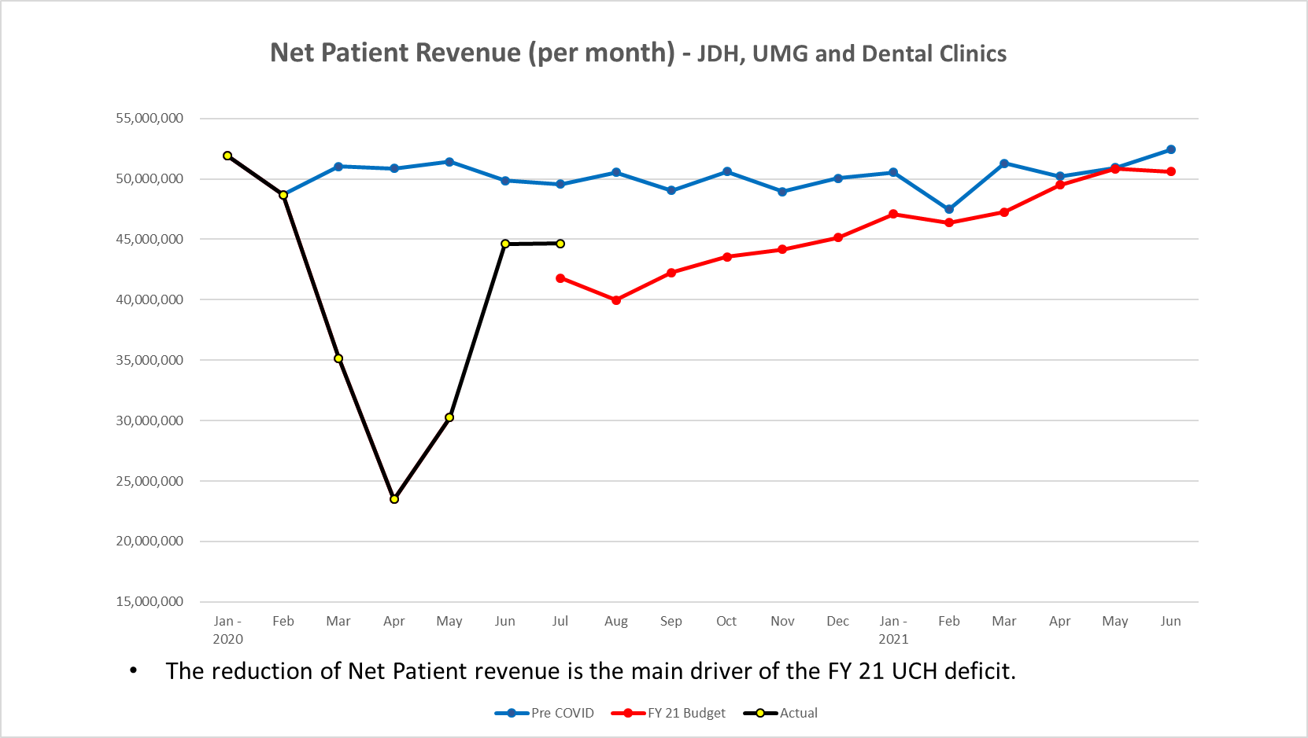
UCH Net Patient Revenue is Favorable for the Month of July

Slide 19
FY 2021 Budget Tracker

Slide 20
FY 2021 UCH Financial Improvement Project

Slide 21
FY 2021 Mitigation Identified

Slide 22
FY 2021 Open Mitigation Plans
Per discussions with OPM, for state planning purposes, we have been asked to assume $33.2M for unfunded legacy costs (consistent with Gov. proposed FY 21 budget adjustment during the 2020 legislative session); this represents a portion of the $53.8M we have requested from the legislature to address the financial burden posed by the state’s unfunded legacy costs.

Slide 23
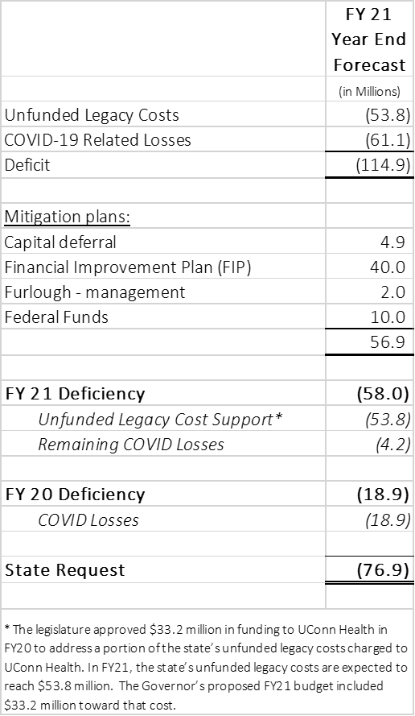
Current State Request
As presented to the Appropriations Committee on August 28, 2020

Slide 24
UConn Health FY 21 Budget
- Adjusted Budget will change each month based on operational performance and accomplishment of outstanding mitigation initiatives.

