Slide 1
Division of Athletics
December 2020 Senate Meeting
David Benedict

Slide 2
Academic Excellence & Community Outreach
3.25 Average GPA among UConn’s 650 SA’s
18 Teams have over an average 3.00 semester and cumulative GPA
1,400 Hours of community service work (18-19)
Note – The Office of Institutional Research and Effectiveness calculates data for us to report.

Slide 3
Academic Progress Rate (APR)
5 Teams awarded the NCAA’s Public Recognition Award
– Signifying Top 10 status in Academic Progress Rate
985 Athletics overall Academic Progress Rate
12 Teams scored a perfect APR in 2018-19
Latest APR scores that have been released are for the 2018-19 academic year

Slide 4
Student-Athletes
Total Number of SA’s: 609
Total Men: 306 Total Women: 303
Scholarship: 210 Scholarship: 216
Non-Scholarship: 96 Non-Scholarship: 87

Slide 5
Athletics Budget Snapshot

Slide 6
Athletics Fundraising Summary
Year | Total Amount Raised | Total Donors
FY17 | $8 MM | 4658
FY18 | $10.3 MM | 4990
FY19 | $14.3 MM | 4936
FY20 | $26.4 MM | 4343
*Athletics has closed 13 $1MM gifts in the past 3 years. 28 total in history.

Slide 7
Total Revenue Opportunities
Source of Revenue | Amount of Revenue
Football Guarantee Games | $8.05 Million over 5 Years (FY22-FY26)
Increased MBB Revenue | $1 Million
Football TV Contract (CBS) | $500K Annually
Total Revenue Opportunities Exceed: $9 Million

Slide 8
2020-2021 BB Season Ticket Holder Update
Convert to Philanthropic Gift: | $1,431,143
Apply to 21-22 Season: | $1,257,740
Request | # of Accounts | # of Accounts (% of Total) | Philanthropic Gift ($) |  | Apply to 21-22 ($) |  | Refund ($)
 |  |  | Seat Donation ($) | Ticket ($) | Seat Donation ($) | Ticket ($) | Seat Donation ($) | Ticket ($)
Philanthropic Gift | 292 | 15.84% | $406,500 | $404,852
Donate & Apply Balance to 21-22 Season | 948 | 51.41% | $343,487 |  | $217,337 | $985,038
Donate & Receive Refund of Balance | 444 | 24.08% | $123,912 |  |  |  | $98,037 | $475,316
Apply Purchase to 21-22 Season | 3 | 0.16% |  |  | $50 | $949
Full Refund | 94 | 5.10% |  |  |  |  | $64,225 | $148,736
Special Arrangement | 63 | 3.42% | $110,237 | $42,153 | $9,200 | $45,166 | $57,937 | $78,909
Grand Total | 1,844 | 100.00% | $984,137 | $447,005 | $226,587 | $1,031,153 | $220,200 | $702,961

Slide 9
Expense Reduction Opportunities
Reduction of 4 Sports: 124 student-athletes impacted
Reduction of 6 full-time equivalencies
Reduction in summer school
Reduction in scholarship expenses
Travel Reductions: Recruiting, Scheduling, Travel Rosters, Non-essential Travel
Sport Operating Expense Reductions
Total Annual Expenses Reduced by FY23: $10MM

Slide 10
Student – Athletes Impacted
All scholarship commitments will be honored through undergraduate graduation.
Teams will be able to compete in 2020-2021.
Fully support and assist student-athletes interested in the transfer process.
Continued access to all student-athlete support services

Slide 11
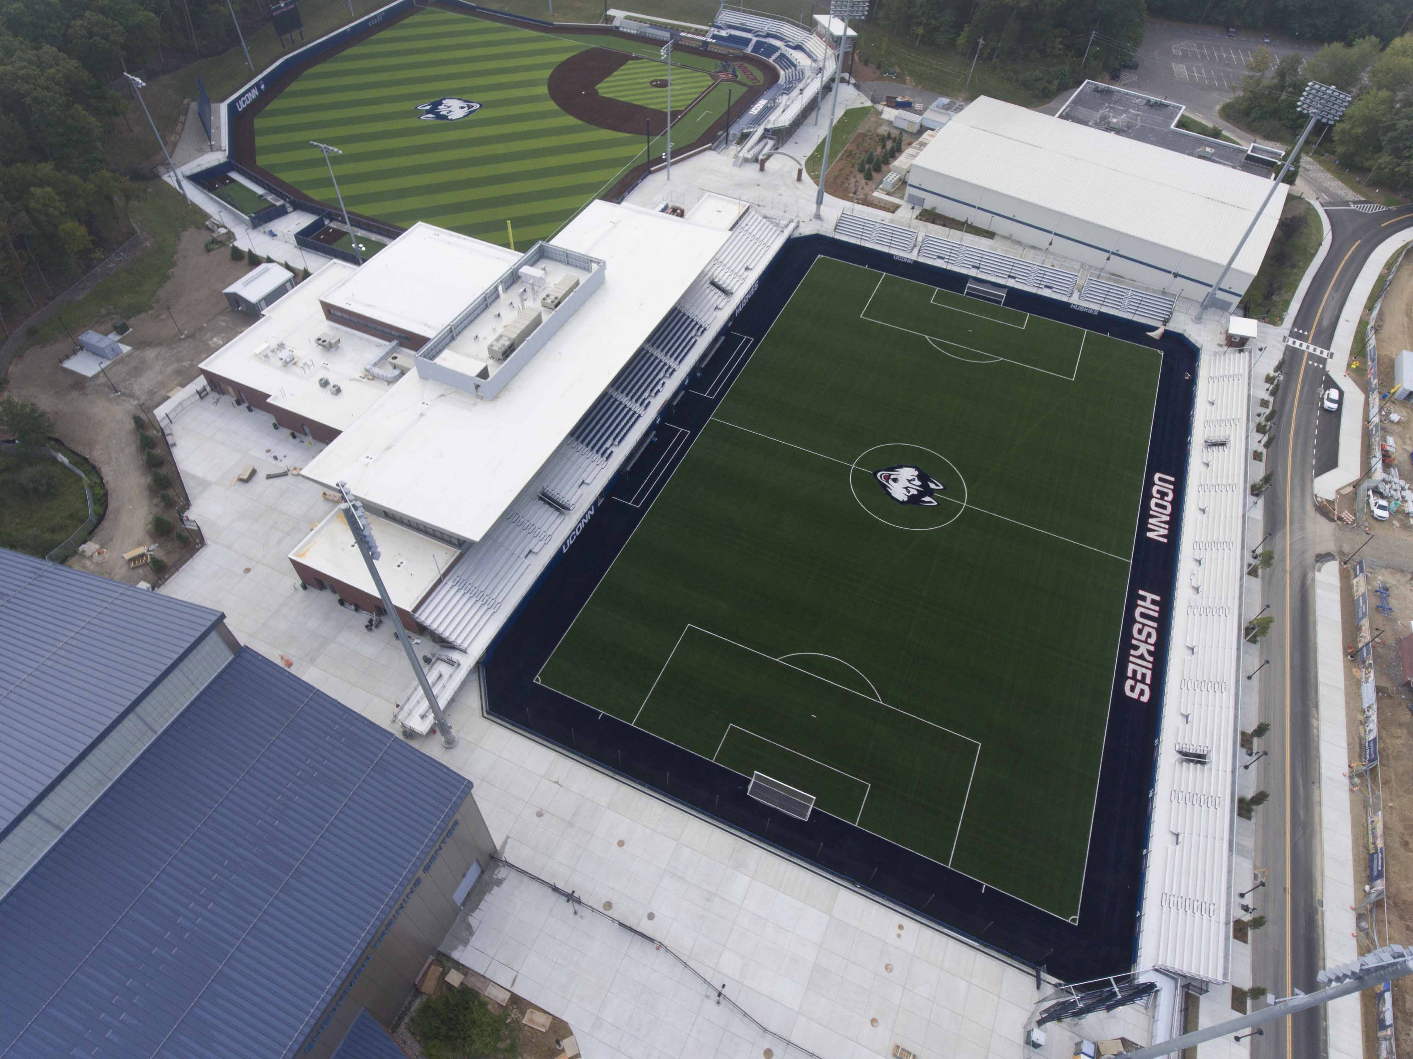
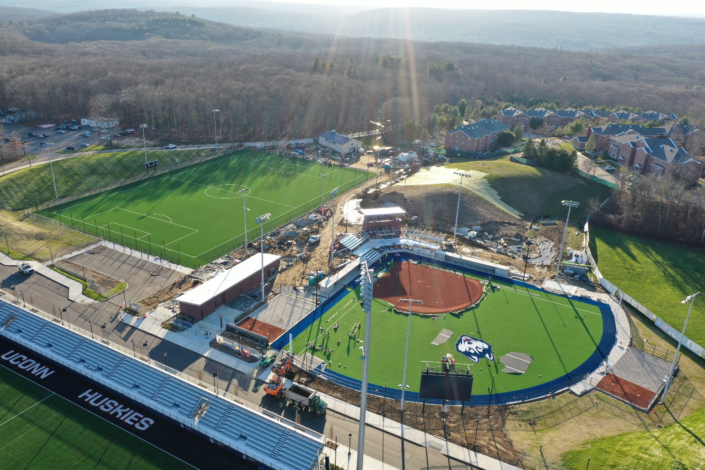
Near Completion of Stadia Project

