Slide 1
Preliminary New Student Enrollment Update Fall 2021

Slide 2
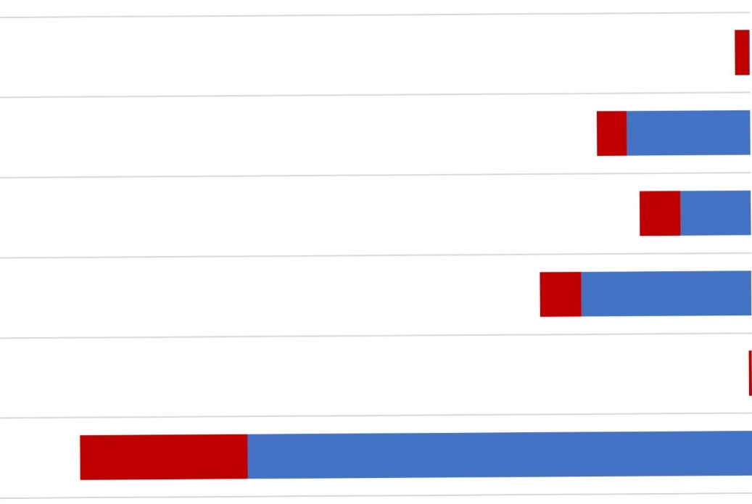
Fall 2021 Highlights Storrs First Year: 3,695
More than
110 International
First Years at
Chinese Partners
46%
of First Year Students are
Ethnic & Racial Minorities
59.4% CT Residents
25%
Federal Pell
Recipients
30 ACT
554 Honors Students
1316 SAT
More than
1 in 4 First Generation
Individual percentages add to greater than 46%, because a growing number of students identify with multiple races or ethnicities.

Slide 3
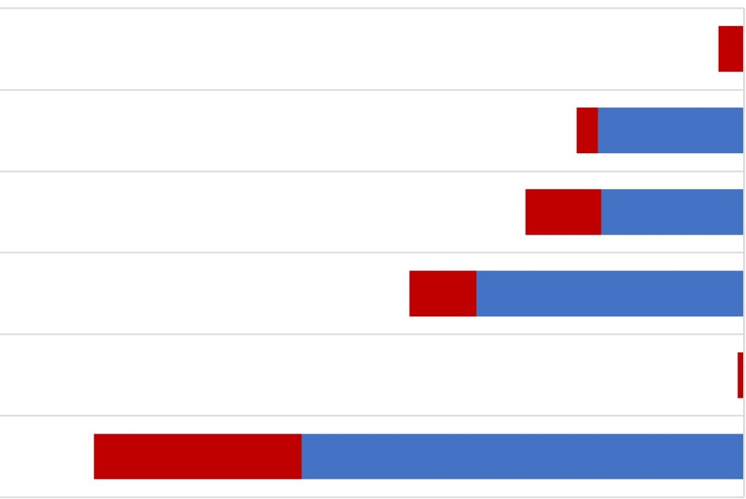
Fall 2021 Highlights Regional First Year: 1,800
57.6%
of First Year Students are
Ethnic & Racial Minorities
93% CT Residents
48%
Federal Pell
Recipients
More than
1 in 2 First Generation
34 Stamford Honors Students
1127 SAT
Individual percentages add to greater than 57.6%, because a growing number of students identify with multiple races or ethnicities.

Slide 4
Fall 2021 Highlights Transfer Students: 869
657 Transfers at Storrs
212 Transfers at the regional campuses
Transfers from 263 colleges & universities
(Including all 12 Connecticut Community Colleges)
82% are Connecticut residents; 18% nonresidents
33% are Federal Pell Grant Recipients

Slide 5
New Student Financial Aid Highlights
 | Fall 2018 | Fall 2019 | Fall 2020 | Fall 2021 | Difference
New First Years receiving Federal Pell Grant | 28% | 29% | 33% | 32% | -1%
New First Years receiving some form of financial aid (loans, grants, scholarships, etc.) | 75% | 84% | 87% | 87% | 0%
New Transfers receiving Federal Pell Grant | 33% | 30% | 34% | 33% | -1%
New Transfers receiving some form of financial aid (loans, grants, scholarships, etc.) | 76% | 74% | 75% | 74% | -1%

Slide 6
Fall 2021 Enrollment Summary
 | Fall 2020 Actual | Fall 2021 Target | Fall 2021 Actual
Storrs First Year | 3,825 | 3,675 | 3,695
Storrs Transfers | 748 | 750 | 657
Regional First Year | 1,795 | 1,800 | 1,599
Storrs Spring Admission | 226 | 175 | 205
Regional Transfers | 247 | 200 | 212
Total New Students | 6,841 | 6,425 | 6,368
 | Fall 2019 | Fall 2020 | Fall 2021
Total Undergraduates* | 23,430 | 23,952 | 23,467

Slide 7
Questions?
Nathan Fuerst, Vice President
Division of Enrollment Planning & Management
nathan.fuerst@uconn.edu
486-1463
Fall 2022 Class https://admissions.uconn.edu/

Slide 8
Supplemental Tables
First Year Application Trends
Storrs First Year Enrollment Detail
Storrs First Year by Ethnicity/Race
Storrs First Year by Schools & Colleges
Regional First Year Overall
Regional First Year by Campus
Regional First Year by Ethnicity/Race
Storrs Spring Admission Cohort
New Transfers Enrollment
Definitions

Slide 9
First Year Application Trends
 | Fall 2017 | Fall 2018 | Fall 2019 | Fall 2020 | Fall 2021
Storrs | 34,198 | 34,885 | 35,079 | 34,434 | 36,751
Avery Point | 224 | 230 | 199 | 206 | 199
Hartford | 322 | 358 | 362 | 360 | 357
Stamford | 1,896 | 2,317 | 1,139 | 1,293 | 1,374
Waterbury | 256 | 239 | 245 | 256 | 246
All Campuses | 36,896 | 38,029 | 37,041 | 36,549 | 38,927

Slide 10
Storrs First Year Enrollment Detail
 | Fall 2017 | Fall 2018 | Fall 2019 | Fall 2020 | Fall 2021
Enrollees | 3,683 | 3,749 | 3,603 | 3,825 | 3,695
Mean New SAT | 1294 | 1306 | 1296 | 1281 | 1316
ACT | 28.7 | 28.6 | 28.9 | 28.9 | 29.7
% URM | 18.8% | 24.4% | 24.2% | 25.3% | 27.5%
% Minority | 35.1% | 39.7% | 41.2% | 44.4% | 46.0%
% In State | 64.5% | 64.3% | 66.2% | 60.0% | 59.4%
% Out of State | 21.5% | 22.7% | 21.2% | 27.9% | 34.1%
% International | 14.0% | 13.0% | 12.6% | 12.1% | 6.5%
Honors Students | 547 | 555 | 582 | 579 | 554

Slide 11
Storrs First Year by Ethnicity/Race*
 | Fall 2017 | Fall 2018 | Fall 2019 | Fall 2020 | Fall 2021
Am Indian/ Alaska Native | 0.1% | 0.2% | 0.1% | 0.0% | 0.1%
Black / African American | 6.8% | 8.0% | 7.5% | 7.5% | 8.0%
Hawaiian / Pac Islander | 0.1% | 0.0% | 0.1 | 0.0% | 0.03%
Hispanic/ Latino | 11.8% | 16.2% | 16.5% | 17.8% | 19.3%
URM Subtotal | 18.8% | 24.4% | 24.2% | 25.3% | 27.5%
Asian | 12.1% | 11.8% | 13.1% | 14.3% | 14.0%
2 or More | 4.2% | 3.5% | 4.0% | 4.8% | 4.6%
Minority Subtotal | 35.1% | 39.7% | 41.2% | 44.4% | 46.0%
Unknown | 2.7% | 2.5% | 2.8% | 0.4% | 0.3%
White | 62.2% | 57.7% | 56.0% | 55.2% | 53.5%
* Percentages exclude international students
URM = Underrepresented Minority

Slide 12
Storrs First Year Schools & Colleges
By School and College | Fall 2020 Actual | Fall 2021 Target | Fall 2021 Actual
ACES | 723 | 705 | 690
CAHNR | 272 | 260 | 297
Business | 485 | 495 | 459
CLAS | 1240 | 1100 | 1224
Engineering Business | 17 | 15 | 13
Engineering | 713 | 720 | 692
Fine Arts | 126 | 160 | 104
Nursing | 123 | 100 | 99
Pharmacy | 84 | 80 | 83
RHAG | 42 | 40 | 34
Grand Total | 3,825 | 3675 | 3695

Slide 13
Regional First Year Overall
 | Fall 2017 | Fall 2018 | Fall 2019 | Fall 2020 | Fall 2021
Enrollees* | 1,609 | 1,806 | 1,738 | 2,021 | 1,804
Mean SAT | 1092 | 1107 | 1113 | 1082 | 1128
% URM | 37.8% | 36.5% | 34.1% | 39.7% | 38.6%
% Minority | 55.0% | 56.3% | 53.8% | 58.9% | 57.7%
* Includes Storrs Spring Admission Students, which began Fall 2017
URM = Underrepresented Minority

Slide 14
Regional First Year by Campus (Excludes Storrs Spring Admits)
 | Fall 2020 Actual | Fall 2021 Target | Fall 2021 Actual
Avery Point | 179 | 200 | 194
Hartford | 578 | 550 | 531
Stamford | 738 | 650 | 629
Waterbury | 300 | 225 | 246
TOTAL | 1,795 | 1,625 | 1,599

Slide 15
Regional First Year by Ethnicity/Race*
 | Fall 2017 | Fall 2018 | Fall 2019 | Fall 2020 | Fall 2021
Am Indian/ Alaska Native | 0.1% | 0.1% | 0.2% | 0.1% | 0.1%
Black / African American | 13.9% | 12.8% | 11.6% | 13.7% | 13.4%
Hawaiian / Pac Islander | 0.0% | 0.0% | 0.0% | 0.0% | 0.0%
Hispanic/ Latino | 23.8% | 23.6% | 22.3% | 26.0% | 25.1%
URM Subtotal | 37.8% | 36.5% | 34.1% | 39.7% | 38.6%
Asian | 13.0% | 15.5% | 15.7% | 13.9% | 13.7%
2 or More | 4.3% | 4.3% | 4.0% | 5.3% | 5.4%
Minority Subtotal | 55.1% | 56.3% | 53.8% | 58.9% | 57.7%
Unknown | 1.5% | 1.1% | 1.4% | 0.3% | 1.0%
White | 43.4% | 42.6% | 44.8% | 41.1% | 41.4%
* Percentages exclude international students
URM = Underrepresented Minority

Slide 16
Storrs Spring Admission Cohort
 | Fall 2018 | Fall 2019 | Fall 2020 | Fall 2021
Avery Point | 25 | 10 | 40 | 12
Hartford | 93 | 68 | 88 | 39
Stamford | 27 | 25 | 43 | 126
Waterbury | 29 | 18 | 55 | 29
TOTAL | 174 | 121 | 226 | 205

Slide 17
New Transfers Enrollment
 | Fall 2017 | Fall 2018 | Fall 2019 | Fall 2020 | Fall 2021
Storrs | 851 | 764 | 735 | 748 | 657
Regionals | 261 | 207 | 216 | 247 | 212
Total | 1,112 | 971 | 951 | 995 | 869

Slide 18
Definitions
First Generation Student – a student for whom neither parent/guardian has earned a bachelors degree or higher. Determination based on student responses on the application for admissions
Minority Student – Includes students who indicate ethnicity/race of either Hispanic/LatinX, Asian, American Indian/Alaska Native, Black/African American, Native Hawaiian or Other Pacific Islander or Two or More.
Underrepresented Minority (URM) Student – Includes students who indicate ethnicity/race of either Hispanic/LatinX, American Indian/Alaska Native, Black/African American or Native Hawaiian or Other Pacific Islander.
Storrs Spring Admission – these are students in the entering first year cohort at the regional campuses who spend their first term at the regional campus, and move to Storrs for their spring term, having met certain conditions (e.g. minimum GPA)

