Slide 1
Supporting faculty and student success
Peter Diplock, Associate Vice Provost
Center for Excellence in Teaching and Learning (CETL)
University of Connecticut Senate Presentation 10-02-21

Slide 2
Resources to Support Faculty Success ‘in the classroom’
Confidential one-on-one Consultations (SET’s, teaching portfolios, instructional and classroom management strategies, etc.)
Teaching Observations (not for SET+)
Workshops, Teaching Talks, Faculty Learning Communities, Interactive Webinars, Reading Groups
>9,000 registrants (faculty, staff, TA’s) for CETL events last year (fins.uconn.edu)
Technology for remote instruction
Equity minded and inclusive teaching
Evidence based practices that improve teaching and learning outcomes
Instructional design/course design support for online and blended courses

Slide 3
Popular Stuff
HuskyCT basics
Organizing course material in HuskyCT
Kaltura: Creating and sharing videos in your class
Adapting to teaching with a mask on
Facilitating class discussions
Equity and Inclusive Teaching in Distance Learning: A Practical Overview
Principles of Universal Design to Support Learners with Disabilities
Bringing antiracist pedagogy to every classroom
Racism in the margins: Antiracist approaches to writing instruction
Writing an effective diversity statement
Writing an effective teaching philosophy statement
The teaching persona
First impressions-first day of class

Slide 4
Evaluation of Teaching
Student Evaluations of Teaching (SET’s)
We work with individual faculty to extract meaningful insights from SET’s
We also provide a ‘CETL SET reader program’ that provides faculty with an opportunity to get ‘themed’ insights
We work with individual faculty to improve quality and quantity of student response
SET + (recognition that SET’s should not be used as the sole criterion of teaching effectiveness)
Engagement with academic departments to develop strategies and measures
One size does not fit all (department culture and context matters)
Typically involves collaboration between CETL staff and department committee charged with SET+
Examples include peer-based observation, learning materials review, teaching portfolios, formative assessment of teaching combined with reflection and action plan
CETL staff do not do classroom observations for SET+ purposes

Slide 5
eCampus: Support for Course Development
Multiple levels of support across all modalities including $7,500 course development stipend for select online courses (high demand/high enrollment summer-winter, graduate programs)
Team of experienced, creative, and supportive Instructional Designers
Team of experienced, creative, and supportive Educational Technologists and Media Producers

Slide 6
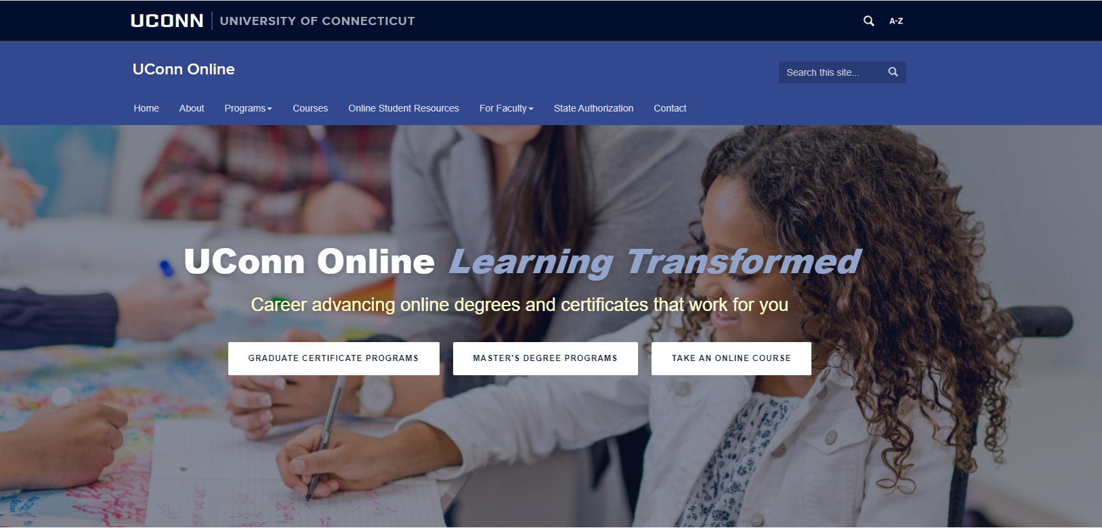

Slide 7
eCampus: Support for Course Development
Notes:
New Programs; Online MBA, Nurse Leader, Nurse Educator, Personalized Nutrition, Graduate Certificates in Dementia Care, Remote Sensing and Geospatial Data Analytics

Slide 9
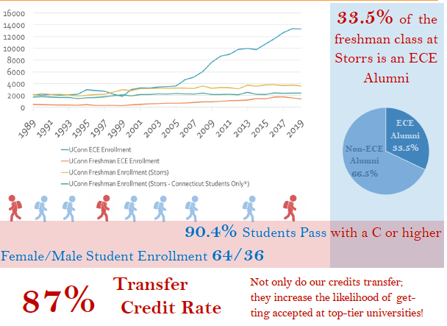
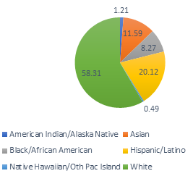
UCONN
ECE

Slide 10
Spring 2020
Summer 2020
4081 students (99% completion rate)
1093 faculty and staff (45% completion rate)
636 students (98% completion rate)

Slide 11
U.S. Anti-Black Racism Pop Up Course
Fall 2020
Spring 2021
Fall 2021
1405 students (97% completion)
511 faculty/staff (21% completion)
1092 students (98% completion)
145 faculty/staff (31% completion)
827 students enrolled

Slide 12
Climate Crisis: Take Action Pop Up Course
Spring 2021
Fall 2021
1253 students (92% completion)
72 faculty and staff (24% completion)
1123 students enrolled fall 2021

Slide 13
Upcoming Pop Up Courses Spring 2022
Anti-Asian Racism (first seven weeks)
Anti-Semitism (second seven weeks)

Slide 14
Summer & Winter Programs
Winter 2021 down 18% from Winter 2020
Summer 2021 down 18% from Summer 2020

Slide 15
University Writing Center Racism in the Margins

Slide 16
University Q Center

Slide 17
University Advising: NEXUS

Slide 18
Questions?
Peter Diplock, Associate Vice Provost
Center for Excellence in Teaching and Learning (CETL)
University of Connecticut Senate Presentation 10-02-21

