Slide 1
Report to the University Senate on the
Regional Campuses
Carl Lejuez, Provost
March 7, 2022

Slide 2
Regional Campuses
Avery Point Campus
Annemarie Seifert, Director
Hartford Campus
Mark Overmyer-Velázquez, Director
Stamford Campus
David Souder, Interim Director
Waterbury Campus
Angela Brightly, Interim Director

Slide 3
Avery Point Campus
Student Outcomes
A positive outcome of the pandemic is increased student awareness of the Avery Point Academic Center which has seen an overall 112% increase in activity over the previous year
Introductory Biology lab courses utilized undergraduate TA’s to assist during lab instruction providing students with an opportunity to continue in-person labs through the pandemic
Academics and Research
CT Initiative on Environmental Research of Offshore Wind (CIEROW)
Avery Point UG, Mona Peyravi, recipient; ASA Connecticut Space Grant Consortium’s Undergrad Research Grant for her work Supporting Inclusive Group Work in Studio-Style Physics Courses
Outreach and Community Engagement
Avery Point Athletic department volunteered roughly 200 hours to local organizations in 2021-22
Avery Point faculty, staff, students, and family members raised the 2nd highest amount in donations for the American Heart Association Eastern CT Heartwalk
DEI
Fall 2020 establishment of the Avery Point Diversity, Equity, and Inclusion Committee
Marine Sciences selected to partner with American Geophysical Union (AGU) Bridge Program
New Avery Point Faculty Learning Community: STEM Disability
Enrollment Data
Total Enrollment Fall 2021: 550
UG: 458; Grad: 56; Non-Degree: 36
Student-Faculty Ratio: 16:1
First-generation students: 39%
Students of color: 34%
First year retention rate (F20): 81%
CT National Estuarine Research Reserve (NERR) – Jan 2022
NOAA funding - $750,00/yr
Reserve includes AP campus
Functions as a Center under OVPR
Individual Accomplishments
Dr. Senjie Lin, Marine Sciences, profiled on AAAS Member Spotlight; Dr. Noemi Maldonado-Picardi, recipient of the 2021 Outstanding Professional Staff Advisor Award

Slide 4
Hartford Campus
Student Outcomes
Majority first-gen campus; increased first-year retention rate from 83% in 2017 to 85% in 2020
COVID has impacted student outcomes
2,445 student sign-ins to the Academic Achievement Center with an average gpa of 2.96
UConn Connects: 70% success rate for students on probation; 31% of successful students > 3.0 gpa
Academics and Research
Sustainable Global Cities Initiative (SGCI):
3 external grants under review ($3.5M); 3 grants in works: NSF, Kauffman & CT Health Foundations ~$3M
Anti-racism, Education, & Community Symposium $15k funded by FIIREGS Grant
New SGCI Faculty Fellowship Program
Hiring search is underway for next CT State Historian
Outreach and Community Engagement
Collaborating with ISS on grants to bring ConnCAP and Upward Bound to Hartford Public Schools
Designed First-Year module for students: Faith in the University: Appreciating UConn’s Multi-Religiousness in collaboration with Hartford International University for Religion and Peace
Developed Anti-Racism, Education and the Community Symposium with Hartford’s HartBeat Ensemble with play based on UConn BIPOC student experiences in the classroom
DEI
Working with heartbeat ensemble to provide DEI training in April with Campus students, staff, and faculty.
With recent new hires, campus staff is now comprised of 48% BIPoC
-2017-2021 UG enrollment from 1200 to 1650 (Federally designated MSI, AANAPISI, emerging HSI)
New SFA Graduate Program; space in Wadsworth Atheneum Museum
By 6 mo post-graduation, 82% of students employed with the vast majority employed in CT
Accomplishments
$1M for scholarships (The Hartford)
Alumni successes
July Leon, Obama Fellow
Dave Steuber, Hartford Mayor’s Chief of Staff

Slide 5
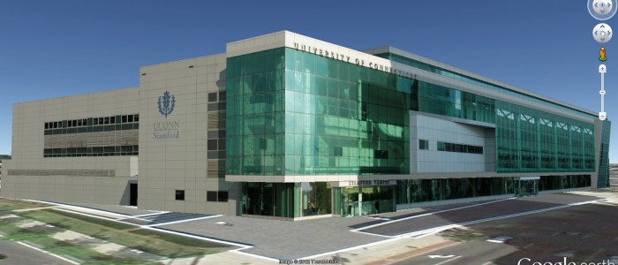
Stamford Campus
Student Outcomes
77% retention after 1 year, 58% graduated in six years
Academics and Research
Introduced interdisciplinary faculty research series
MS in Fintech to launch Fall 2022
Outreach and Community Engagement
Partnerships with AT&T to install 5G hotspot & Synchrony for on-site internships
New internships at GE Appliances Co-Create facility
Launched Stamford Startup Studio; 2 semester entrepreneurial co-op with Werth Inst
DEI
Launched Affinity Center
Applied for recognition as Hispanic Serving Institution (HSI) – 31% of UG students
Other Accomplishments
Visits from Mayor Simmons, Governor Lamont, and Senator Blumenthal
Partnered with Netflix to have two movies filmed on campus
Fall 2021
Enrollment: 2,405 UG + ~ 500 Grad
Students of Color (UG): 66%
1st Gen Students (UG): 48%
DMD Assistant Professor Oscar Guerra won two Emmy awards for his documentary
Team of MS students in Financial Risk Management won 1st place in international Bloomberg trading competition

Slide 6
Waterbury Campus
Student Outcomes and Updates
For Waterbury students on probation, 75% retained after fall 2021
Piloting Advising Academic Success Plan for Scholastic Standing to support students on probation
New student lounge space opened fall 2021, tripling student space on campus
Academics and Research
35% enrollment growth in Allied Health from fall 2020
Science lab expansion: Anatomy & Physiology, Biochemistry, Organic Chem Lab
Physics faculty research project on “Mixed Reality-Based Physics Instruction” OVPR grant funded, extended to include Storrs Physics faculty and Salisbury University
Outreach and Community Engagement
Partnerships with Waterbury Health Dept, Health 360, Center for Human Development, St. Mary’s Hospital, Griffin Hospital, Access Rehab, WTBY Chamber of Commerce Healthcare Council, United Way of Greater Waterbury
Waterbury Community Garden (9th yr) provides produce to food-insecure residents of Greater Waterbury – partnering with Osher LLI and funded by CT Community Foundation
DEI
Active Campus Diversity, Equity and Inclusion Committee
CLAS grant for DEI performance, Social Identity Activity workshop for FYE and campus
Enrollment
272 Fall 2021 1st Year Admits; 920 Total Enrollment
55% Students Are First Generation
53% Students are Racial and Ethnic Minorities
55% Receive Need-based Grants
HSI Recognized Campus
Hispanic-Serving Institution: Eligible for HSI authorized grants to help augment opportunities for Hispanic students, financial wellness support, upgrade facilities, community outreach, etc.
Waterbury Promise
Partnership between City of Waterbury/UConn available to Waterbury’s graduating high school students. The Waterbury Promise Scholars at UConn will receive $5,000 per year from the University to be split between fall and spring semesters, paired with generous need-based scholarships from the Promise program.

Slide 7
Report to the University Senate on
Undergraduate Education and Instruction
Michael Bradford, Vice Provost
March 7, 2022

Slide 8
Undergraduate Education & Instruction
Center for Excellence in Teaching and Learning (CETL)
Associate Vice Provost Peter Diplock
Honors and Enrichment Programs
Associate Vice Provost Jennifer Lease Butts
Institute for Student Success (ISS)
Associate Vice Provost Tadarrayl Starke
Center for Career Development (CCD)
Assistant Vice Provost James Lowe
Veterans Affairs and Military Programs (VAMP)
Director Alyssa Kelleher
Student-Athlete Success Program (SASP)
Director Ellen Tripp

Slide 9
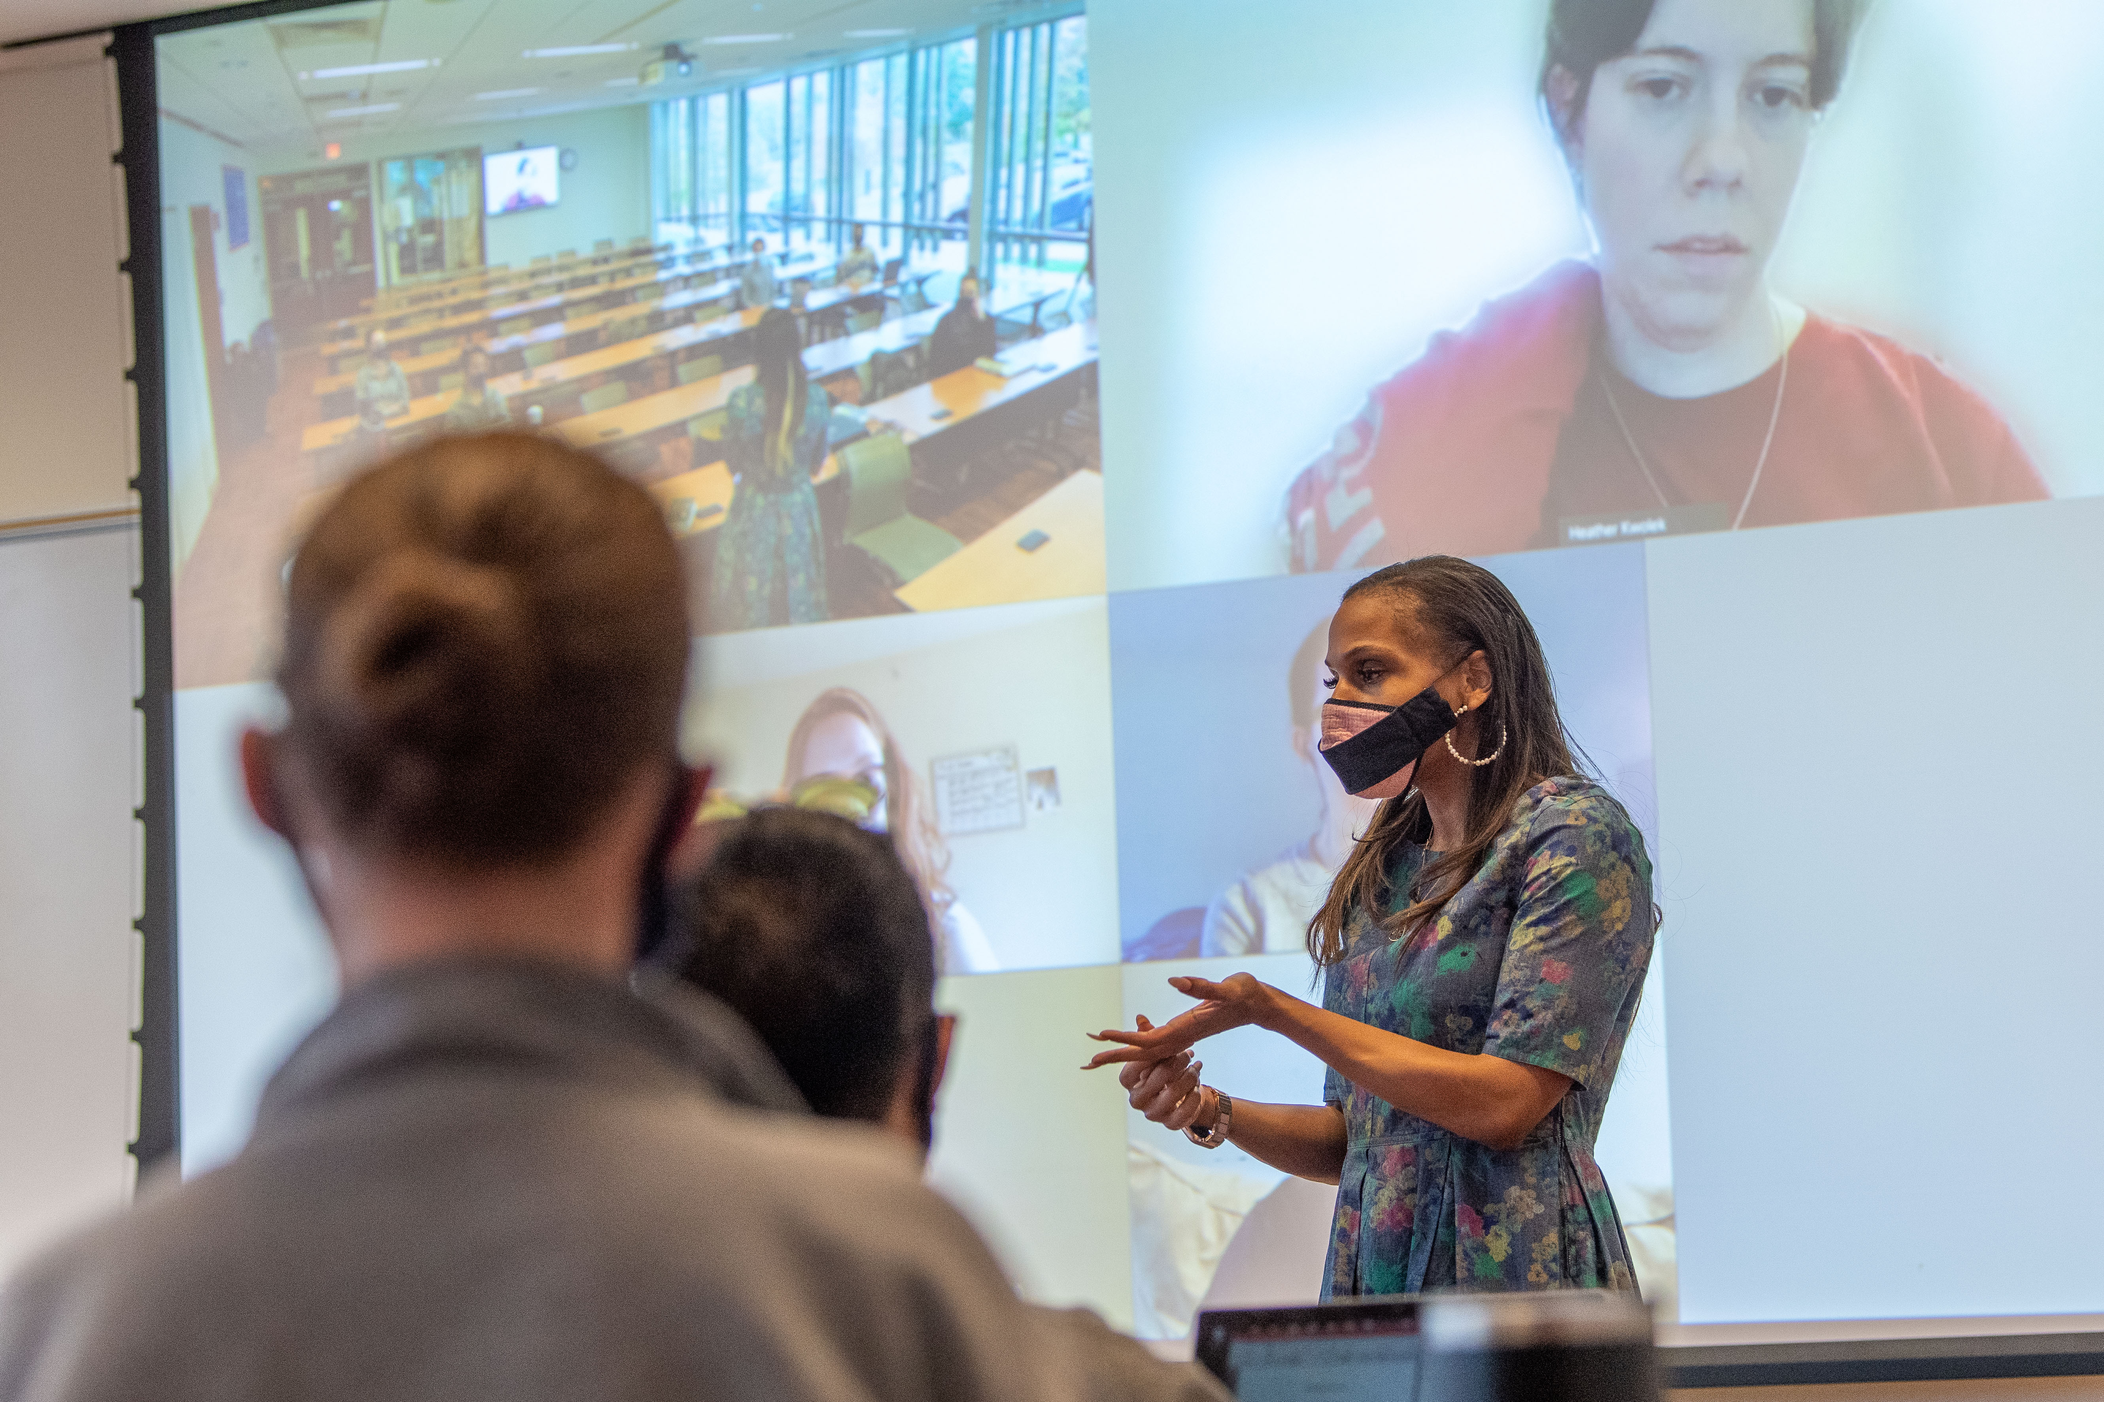
Center for Excellence in Teaching and Learning
Significant Accomplishments
CETL’s team of faculty development, eCampus, and educational technology staff provided extensive training to more than 8,000 participants in workshops and webinars, >500 individual consultations, and extensive support for all instructors
Supported development and launch of Pop-Up Courses: U.S. Anti-Black Racism (4,000 enrollments F20, S21, F21), Climate Crisis: Take Action (2,000 enrollments S21, F21), Confronting Anti-Asian Racism (1,800 enrollments S22), Why the Jews? Confronting Anti-Semitism (1,300 enrollments)
Enhanced depth and breadth of DEI programming in collaboration with ODI and
other partners to advance equity minded and inclusive teaching practices
Writing Center collaboration with CAP/ISS and UConn Cultural Centers launched
Racism in the Margins conference (600 participants) and ongoing workshops on
anti-racist writing assessment
UConn Early College Experience (ECE) enrolled 12,571 students attempting 76,000
credits partnering with 208 high schools and 1,487 certified UConn ECE instructors
eCampus supported development of 65 online courses, 46 GRAD & 19 UGRD and
our web and digital marketing team continue to support 50 online graduate degree
and certificate programs including top ranked programs from Nursing, Business, ISG
CAHNR, Engineering, Neag, CLAS https://online.uconn.edu

Slide 10
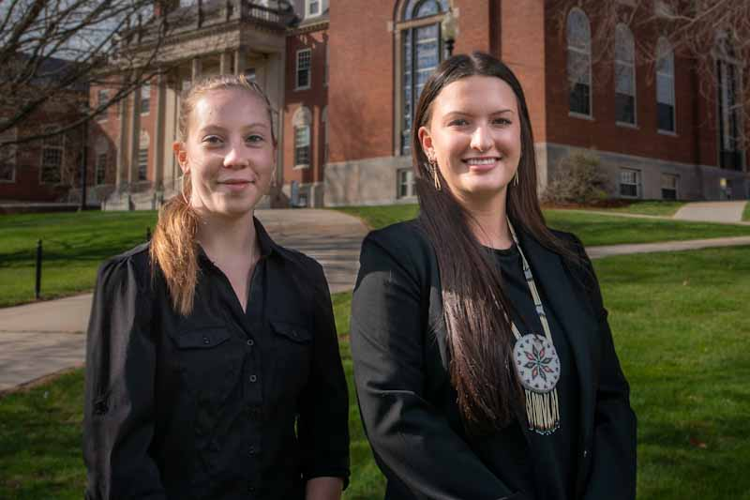
Honors and Enrichment Programs
Office Accomplishments
Implemented a new application for the University Scholar Program that enhances the holistic review of applicants.
New Initiatives
Redesigned medical and dental applicant advising to be more competency-based, developmental, and student-centered.
Partnerships
BOLD collaborated with Educational Leadership to develop a Graduate Certificate in Emerging Women’s Leadership.
DEI
Cross-EP effort to implement implicit bias mitigation strategies (e.g., in review and selection committee processes).
Individual Accomplishments
Sena Wazer ’22 and Sage Phillips ’22 were named Truman Scholars, the first time UConn had two Scholars in one year.
Honors 1st year incoming class Fall 2021 moved to test-optional:
566 students (Storrs and Stamford)
58% minoritized students 22% first-generation students
16 Honors (GPS) peer advisors hired to help students across the campuses navigate the new Honors requirements.
Disbursed over $630,000 in support of undergraduate research across 207 awards in 10 funding programs.
Notes:
Across Honors and Enrichment Programs, our emphasis over the past year has been on reviewing our programs and services to enhance access and inclusion, ensuring that opportunities for enriched learning and purposeful exploration are available to all UConn students.
The revised University Scholar application integrates an overall statement of interests, learning plan, and project plan. This allows for a more holistic review by the committee as the application now contextualizes the student’s project within their past learning experiences and their broader academic goals for their final three semesters.
In Pre-Professional Advising, changes to the pre-med and pre-dent applicant advising model included the development of a competency-based applicant portfolio and review process, comprehensive advisor review of all materials, enhanced individualized coaching appointments with applicants, the opportunity to meet with more than one advisor on staff, and a shift to a strengths-based, non-evaluative cover letter for applicants to health professions schools.
The BOLD Women’s Leadership Network program collaborated with Educational Leadership on the Emerging Women’s Leadership Graduate Certificate. Post-graduate fellows from UConn’s BOLD program and other BOLD programs will be able to enroll in this program, providing a supportive structure for their exploration of leadership during their fellowships at non-profit organizations. The certificate will also be available to other interested students once it is approved and finalized later this year.
DEI efforts included staff trainings on implicit bias and reviewing our application and selection processes across EP units. As an example, we have eliminated the need for faculty/staff recommendations from some programs as a result of research that suggests this may be a barrier for minoritized and 1st Gen students. In reviewing our processes, if we found that recommendations were having little to no effect on the outcome of the application, we eliminated this requirement to eliminate potential barriers.
Sena Wazer ‘22 (CLAS) and Sage Phillips ‘22 (CLAS), pictured here, became UConn’s 8th and 9th recipients of the Truman Scholarship, marking the first time two UConn students received this award in the same year.
Other highlights include:
Total Honors first-year admission Enrollment at Storrs and Stamford 2020 vs. 2021 (bold type used to indicate important changes in numbers)
Total Honors Enrollment: 591 to 566
% First-Generation: (10% to 22%; +12%)
% Minority (44% to 58%; +14%)
American Indian (0% to 0%; no change)
Asian (24% to 19%; -5%)
Black (4% to 9%; +5%)
Hawaiian (0% to .2%; +.2%)
Hispanic (10% to 26%; +16%)
Multiple (6% to 5%; -1%)
International (1.9% to .2%; -1.7%)
Unknown (.5% to .2%; -.3%)
White (54% to 41%; -13%)
Additional student staff members hired as peer advisors in order to support students in the transition to the new Honors graduation requirements.
Strong financial support ($630,000) for students involved in undergraduate research across our 10 funding programs continued. This is an indication of research mentors’ on-going commitment to engage students in inquiry across our campuses, despite the challenges of the pandemic, as well as the commitment of donors and the university to fund these LTE experiences for students.

Slide 11
Institute for Student Success
Office Accomplishments
Received $2.5 million 5-year renewal for the NSF-funded LSAMP program
Awarded $4.23 Million in additional grants to promote college access & success for underrepresented students at UConn and across the State
New Initiatives
Expanded pre-college access programming to all 5 UConn campuses, serving 1400+ middle & high school students across the state
Launched 2 First Gen FYE and First Gen First Year Writing sections
Established 2 new Learning Communities (ASL & Deaf Culture and Neurodiversity in Engineering)
Launched the Office of Student Retention to better support student success efforts across the UConn system
Student Success Highlights
Achieved 97% 1st-Year Retention rate for ScHOLA2RS House students (14% higher than all other UConn Black males)
Fall 2021: Learning Community students’ GPAs 4% higher than non-Learning Community students
44% decrease in CAP/SSS student DFW rates (Fall 2020 to Fall 2021)
100% of students in ISS Pre-College Programs graduated high school in 2021
Innovative Programming
CAP/SSS partnered with Global Affairs to provide 19 students virtual summer global internships and a winter domestic cultural experience in Hawaii in 2021
FYE enrolled 93% of 1st Year students at Storrs.
Since 2016, LSAMP UConn has seen a 62% increase in participation
20% of students served by ACES are non ACES-students seeking advising
Staff Recognition:
Dr. Bidya Ranjeet - 2022 Outstanding Alumni Award, Neag School of Education
Helena DeBald – Recipient, LTE Design Sprint Grant

Slide 12
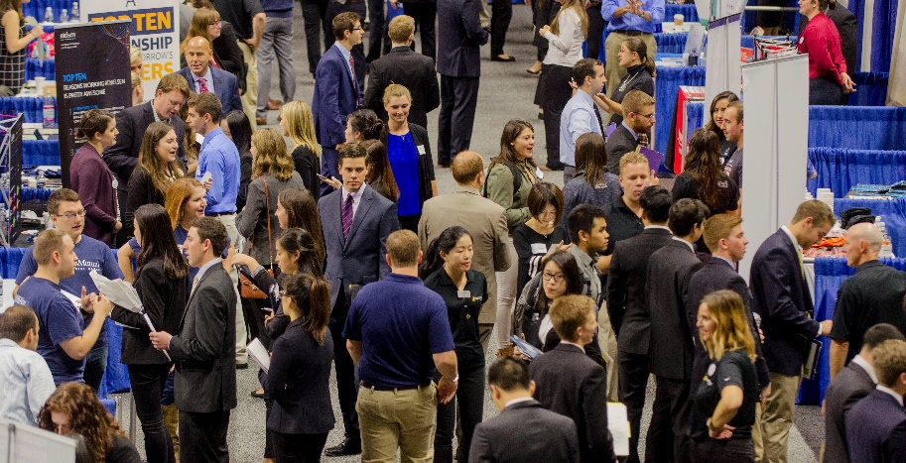
Center for Career Development
Office Accomplishments
National Career Leadership Collective (CLC) Award for Innovation in Programming
National Association for Colleges and Employers (NACE) Members Choice Award Finalist – Innovation in Programming
NACE22 National Conference Presentation: Engaging Career Champions to Support a Mission of Career Everywhere
Multiple virtual presentations at NACE, Eastern Association of Colleges and Employers (EACE), CLC and NASPA
New Initiatives
Conducted IRB-approved research study on the impact of identity on career development, receiving 1,500 responses
Entrepreneurship Month – partnering with Connecticut Small Business Development Center and community partners
Developed and implemented a 5-part career-readiness curriculum for La Comunidad Intelectual Learning Community
Collaborated with CETL to integrate career readiness concepts into the classroom
Partnered with Student Employment to expand development of students through on-campus internships
Partnered with Universitas 21 and other member institutions to launch global virtual micro-internship program
Partnerships
Chair Corporate Advisory Council consisting of representatives from Connecticut’s largest employers
2,200 Connecticut companies are registered in Handshake, our portal connecting students to employers
2,143 jobs or internships are currently posted, spanning all majors
735 companies and organizations attended career fairs and on-campus interviews
Received $19,000 grant from Collins Aerospace subsidizing women and black students’ conference attendance
DEI
The DEI Committee, in its seventh year, delivered 25+ programs with a specific focus on Diversity, Equity, and Inclusion
NACE Honorable Mention Award for Excellence in Diversity, Equity and Inclusion programming
Presented “Extending Beyond a Committee: Promoting DE&I as an Entire Career Center Team” for the CLC National Conference, NACE Webinar series, and EACE webinar series
Presenting “Researching the Intersections of Identity & Career Development” at the NACE 2022 National Conference
Individual Accomplishments
Received two of the five UConn Spirit Awards; one for University Citizen and the other for Inclusive Excellence
Elected to Board of Directors for National Association of Colleges and Employers
Elected Chair of Employability and Careers Group for Universitas 21
73% vs. 54%
The percent of UConn students utilizing services
provided by the Career Center during their undergraduate experience is 19 percentage points higher than the national average.
STUDENT ENGAGEMENT
5,175 one-on-one coaching sessions
390 career-related presentations
17,396 students active in Handshake
550,990 website page views
CAREER CHAMPIONS
430 faculty, staff, employer, and alumni
26 events with 480 participants
140 faculty and staff requested presentations

Slide 13
Office of Veterans Affairs and Military Programs
Office Accomplishments
Second ever virtual military student orientation; Reinvigorated and improved student employment; Intensive compliance evaluations from both the VA and DoD – VAMP and UConn deemed fully compliant; Continued to extend online and virtual offerings to support students
New Initiatives
Student leader selected to attend conference at West Point; AFROTC relocated in order to better facilitate learning and interactions between students; increase social media presence and brand marketing; increase internal and external outreach
Partnerships
Reinvigorated partnerships with the State and Federal VA in CT; the US Army War College; AROTC and UConn Kinesiology; AROTC and Norwegian Embassy; Maj Rogers-Reed of AFROTC and AACC
DEI
Initial results of research into UConn’s veteran community reveal UConn’s vets are more diverse than the military overall or the CT National Guard; AROTC appoints first female Ranger Challenge Team Captain; AFROTC’s Maj Rogers-Reed recognized for her inclusion and outreach work
Individual Accomplishments
Bethany Grabowski, Program Assistant recognized regionally as University Employee of the Quarter for AFROTC
Over 800 military affiliated students throughout all campuses, many of whom deployed overseas in 2021 or in state to help with COVID response.
AFROTC Commissioned 16 Officers
AROTC Commissioned 25 Officers
Veterans History Project poised to begin interviews again as soon as COVID conditions allow

Slide 14
Student-Athlete Success Program
SASP is now located in the Greer Fieldhouse
SASP has partnered with CSD and Mental Health to work collaboratively to enhance learning support services for students.
SASP is working with Mental Health and the Division of Athletics to bring Victoria Garrick, founder of “The Hidden Opponent”, to campus in March, to discuss various mental health strategies and how to create supportive environments.
Alana Butler, Associate Director, is leading the DEI Committee within the Division of Athletics on multiple initiatives such as educational workshops, sponsored speakers, helping organize the first ever Pride games, etc..
65% of our Student-Athlete population achieved over a 3.00 semester and cumulative GPA from Fall 2021
NCAA Graduation Success Rate of 92%
15 Teams achieved over 90%
7 Teams posted a Perfect Score of 100!
Due to NCAA changes in eligibility due to Covid, we have 46 students pursuing graduate degrees.

