Slide 1
Office of the Vice President for Research
University Senate
April 4, 2022

Slide 2
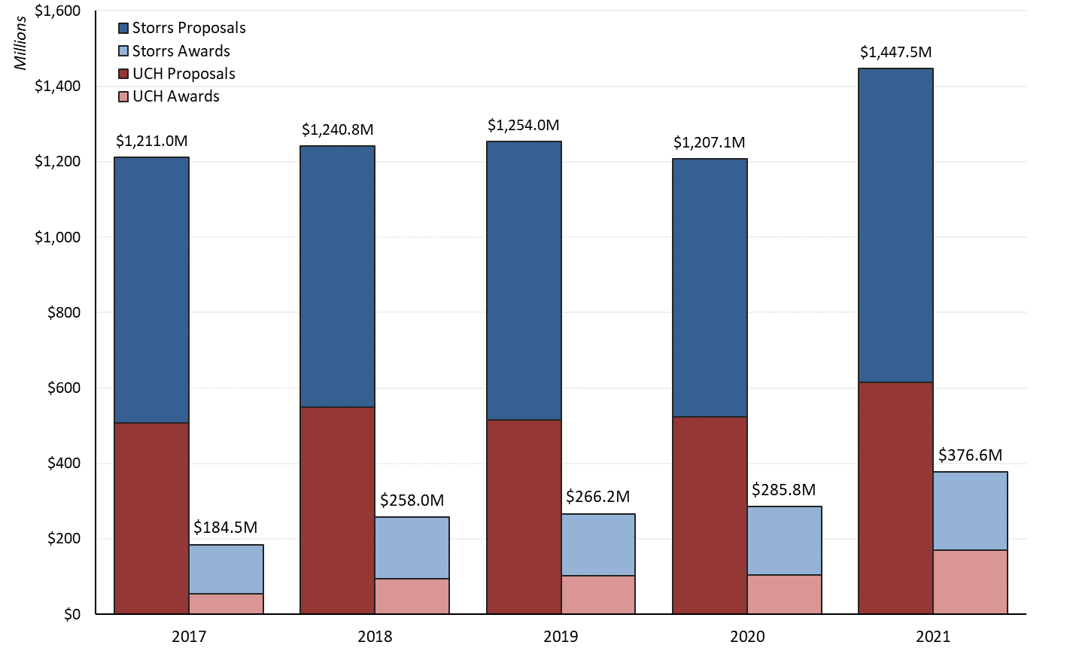
UConn Sponsored Program Activity
Proposals and Awards, FY2017 – FY2021

Slide 3
Update on Submission Deadline Policy
Q1&Q2 of FY22 (July – December 2021)
Proposals Received for Administrative Review | # | % | SPS Review within 3 Business Days
With Firm Deadlines | 609 | 66% | 91%
On-Time Proposals | 513 | 55% | 90%
Late Proposals without Pass | 28 | 3% | 89%
Exceptions to 5-Day Policy
Used Proposal Pass | 28 | 3% | 100%
Short turn-around opportunity | 40 | 4% | 98%
Without Firm Deadlines | 318 | 34% | 94%
Grand Total | 927 | 100% | 92%
100% of proposals with a firm deadline were submitted on time to the sponsor

Slide 4
Update on Submission Deadline Policy
FY21 and FY22 Comparisons(July-December)
Volume of Proposals
  Before 5-Day Policy: 792 proposals received
  After 5-Day Policy: 927 proposals received
Proposals without firm deadlines

Slide 5
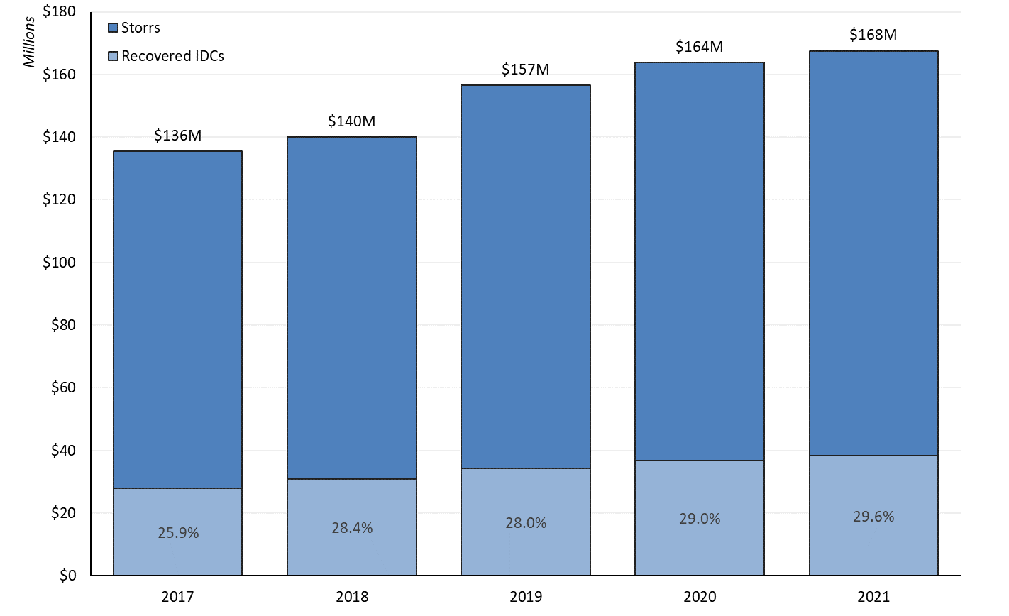
UConn Sponsored Program Activity
Storrs Expenditures, FY2017 – FY2021

Slide 6
Return of IDCs to Support/Grow Research and Scholarly Activities
Return of IDC's to Research

Slide 7
Where the Dollars Go
FY21 Return of IDC's to Research $34.7M

Slide 8

10 NSF CAREER Awards for proposals submitted in 2021
Neag School of Education
School of Engineering
Ido Davidesco, Educational Psychology
Ben Fuller, Computer Science & Engineering
Walter Krawec, Computer Science & Engineering
George Matheou, Mechanical Engineering
Kristin Morgan, Biomedical Engineering
Anna Tarakanova, Mechanical/ Biomedical Engineering
Xueju (Sophie) Wang, Materials Science and Engineering
Hongyi Xu, Mechanical Engineering
College of Liberal Arts and Sciences
Cara Battersby, Physics
Tomoyasu Mani, Chemistry

Slide 9
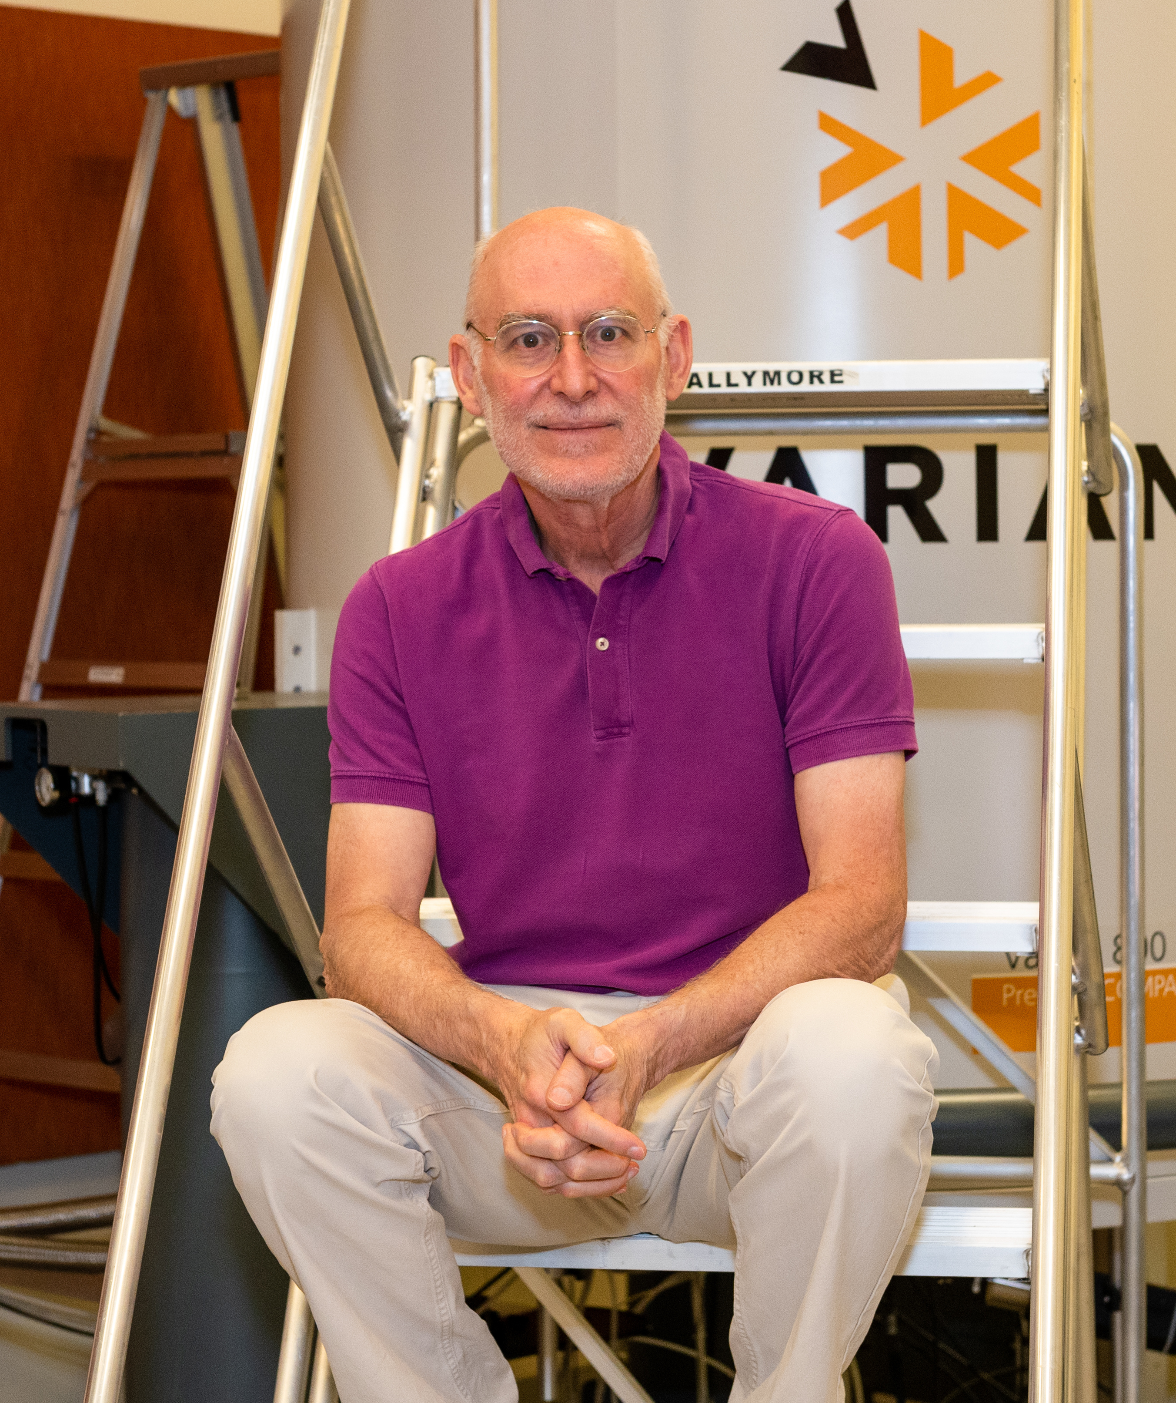
Largest Award in UConn History
$40M Major Research Instrumentation Award
$40M Major Research Instrumentation Award
Network for Advanced Nuclear Magnetic Resonance
Prof. Jeffrey Hoch, UConn Health, PI
Partners: University of Wisconsin, University of Georgia

Slide 10
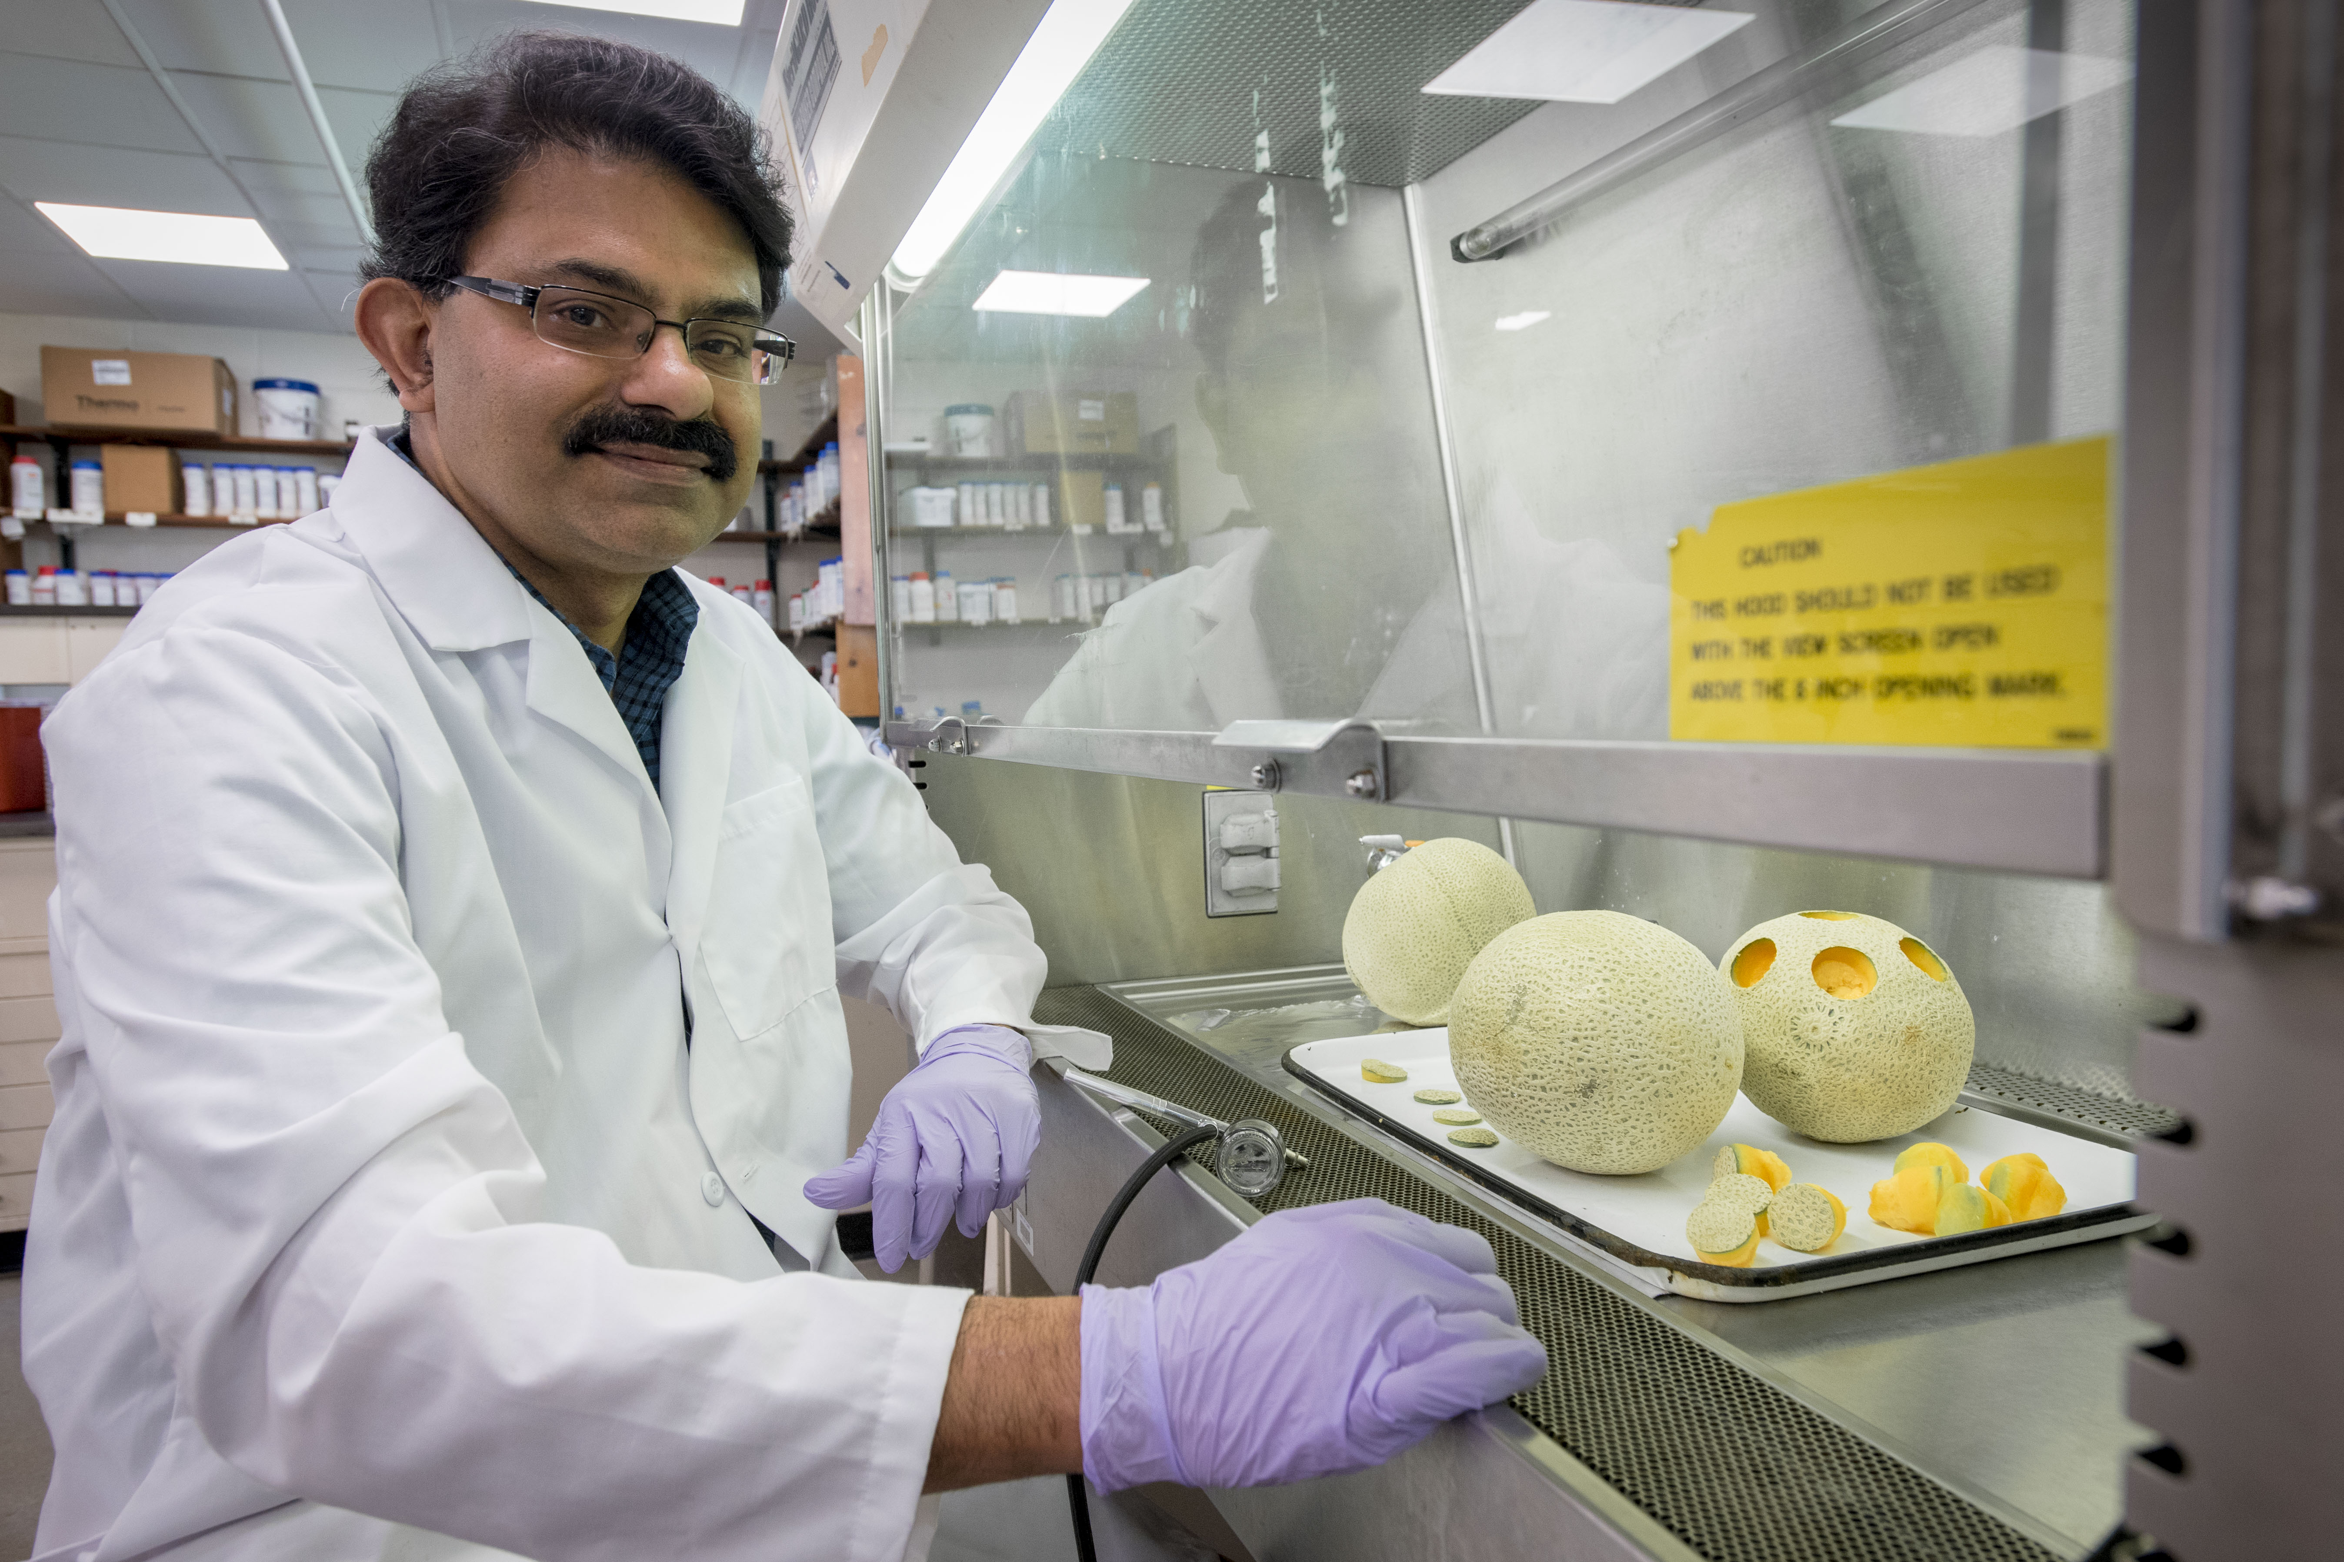

USDA Grant: Sustaining the Food Supply
$10 million USDA-NIFA Award
Professor Kumar Venkitanarayanan, Associate Dean of CAHNR
Developing a sustainable program to phase out use of antibiotics in poultry industry broiler production
Assembled interdisciplinary team of 30 researchers from 13 institutions

Slide 11

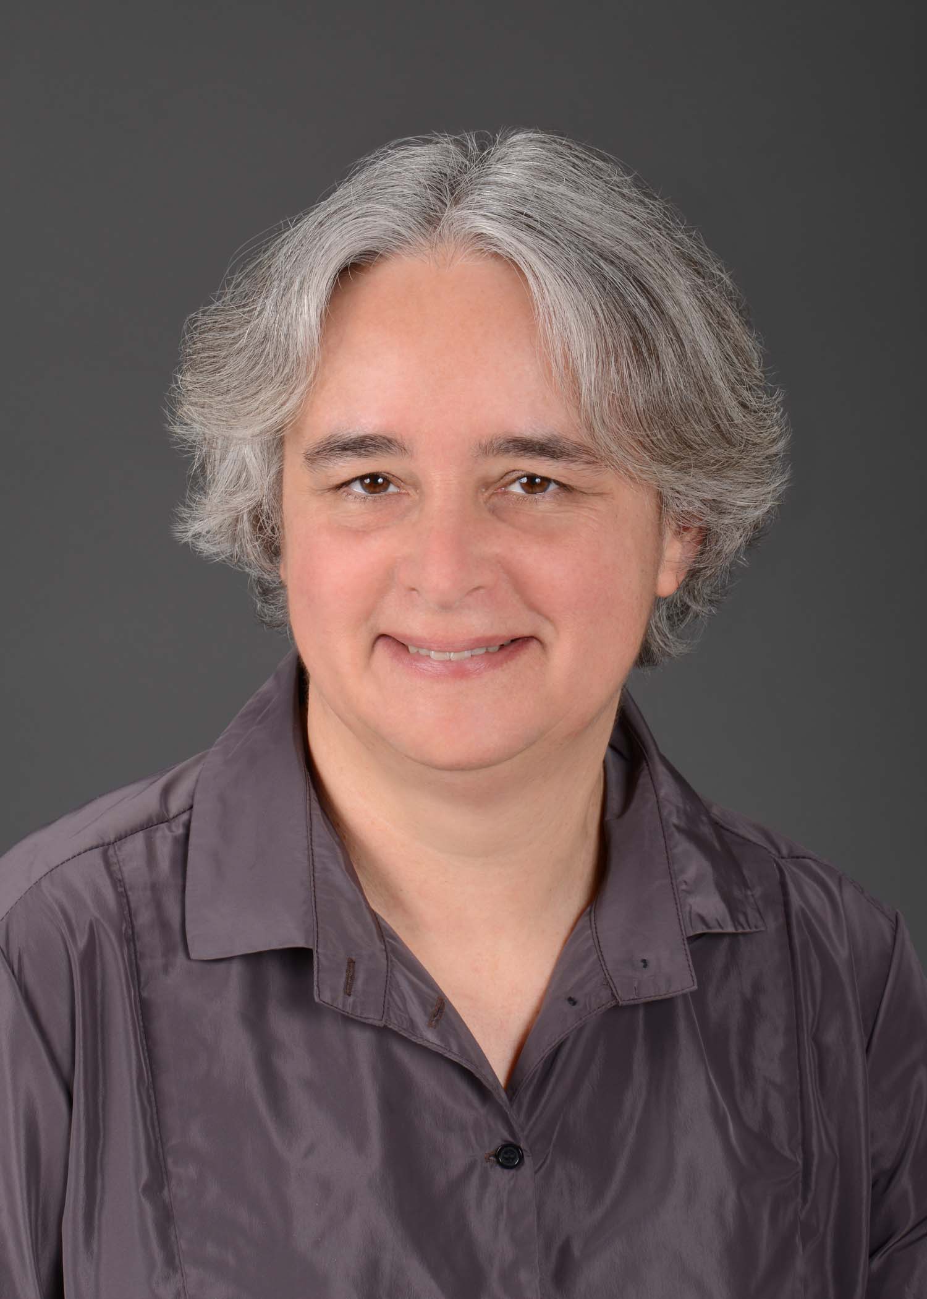
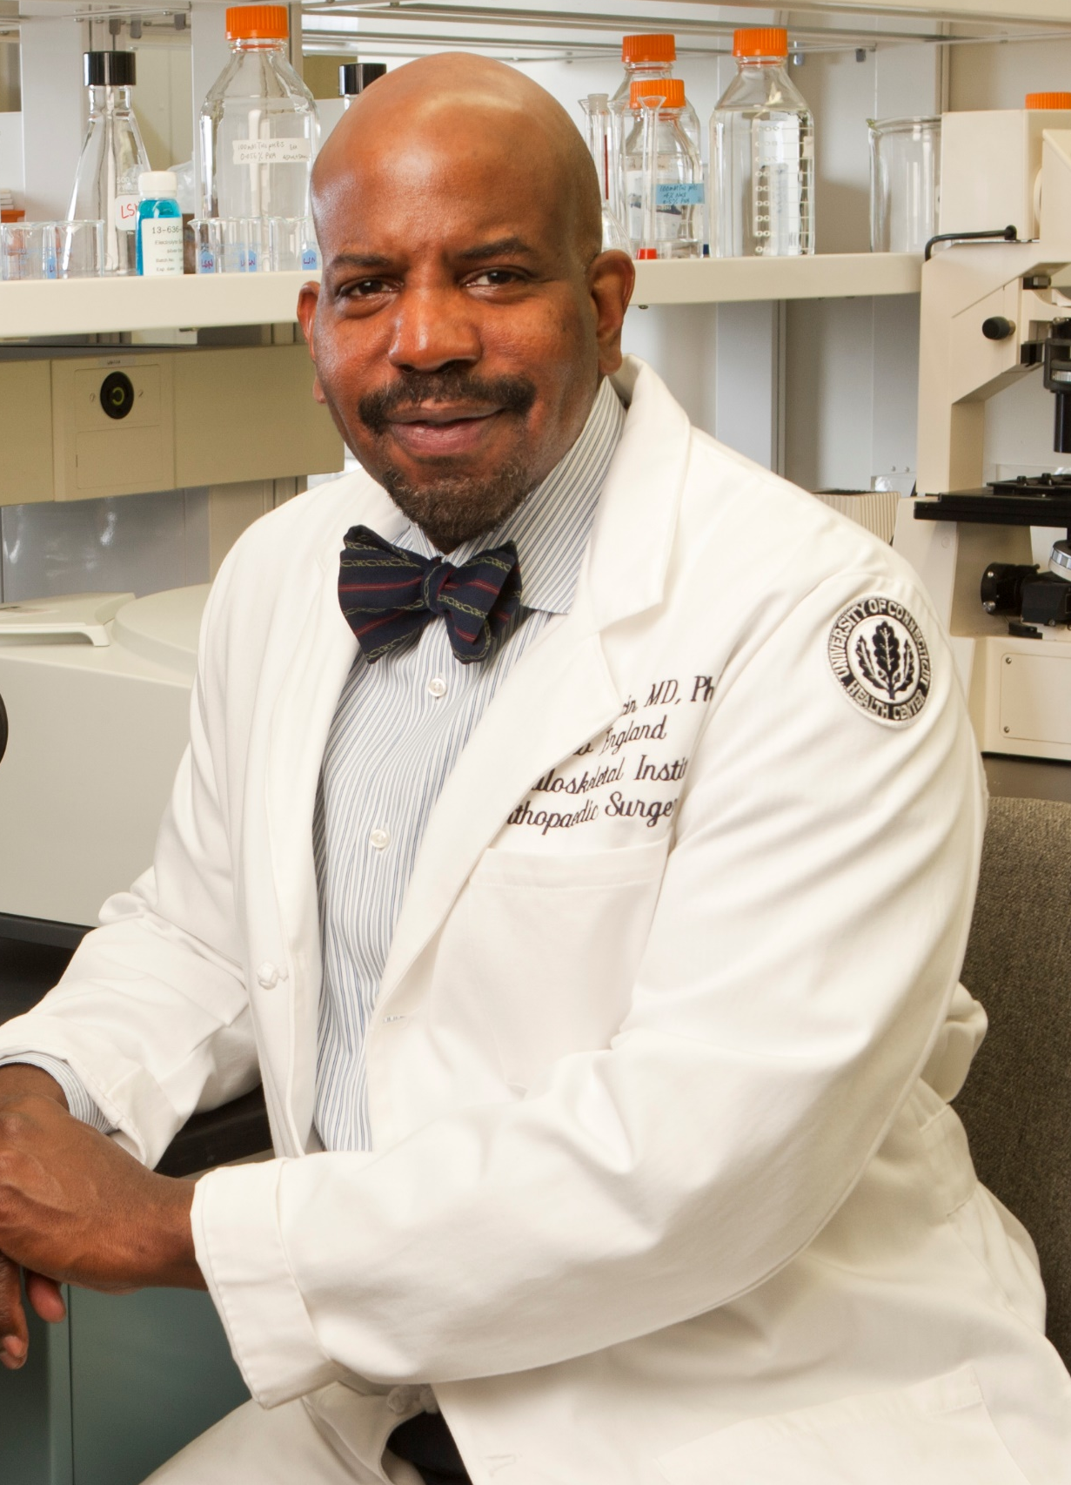
Inductees to the
National Academy of Sciences
Dr. Laurinda Jaffe
Department of Cell Biology
School of Medicine
Pioneering researcher in the field of fertility
Dr. Cato T. Laurencin
School of Medicine
Albert and Wilda Van Dusen Distinguished Professor of Orthopaedic Surgery
Recipient of 2021
NAACP Spingarn Medal

