Slide 1
Preliminary New Student Enrollment Update Fall 2022

Slide 2
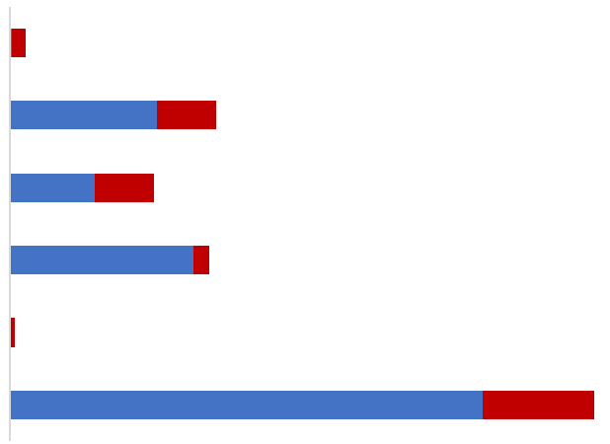
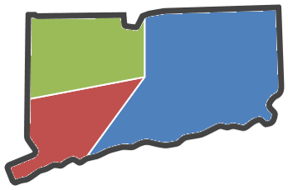
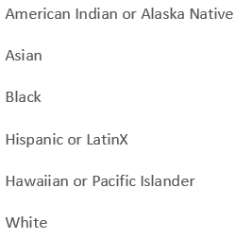
Fall 2022 Highlights Storrs First Year: 4,089
9.5%
International Students
49.6%
of First Year Students are
Ethnic & Racial Minorities
59.4% CT Residents
1.5%
19.6%
13.7%
19%
0.5%
55.6%
25%
Federal Pell
Recipients
30 ACT
554 Honors Students
1316 SAT*
28.5%
First Generation
Individual percentages add to greater than 49.6%, because a growing number of students identify with multiple races or ethnicities.
Notes:
Update charts and data

Slide 3
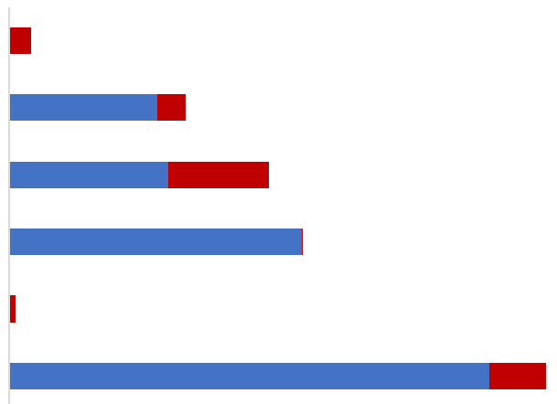
Fall 2022 Highlights Regional First Year: 1,746
57%
of First Year Students are
Ethnic & Racial Minorities
92% CT Residents
48%
Federal Pell
Recipients
1.9%
15.1%
22.2%
25%
0.6%
45.9%
49.7%
First Generation
30 Stamford Honors Students
1111 SAT*
Individual percentages add to greater than 57%, because a growing number of students identify with multiple races or ethnicities.

Slide 4
Fall 2022 Highlights Transfer Students: 937
706 Transfers at Storrs
231 Transfers at the regional campuses
Transfers from 277 colleges & universities
(Including all 12 Connecticut Community Colleges)
86.6% are Connecticut residents; 13.4% nonresidents
30% are Federal Pell Grant Recipients

Slide 5
New Student Financial Aid Highlights
 | Fall 2019 | Fall 2020 | Fall 2021 | Fall 2022
New First Years receiving Federal Pell Grant | 29% | 33% | 33% | 31%
New First Years receiving some form of financial aid (loans, grants, scholarships, etc.) | 84% | 87% | 85% | 87%
New Transfers receiving Federal Pell Grant | 30% | 34% | 33% | 30%
New Transfers receiving some form of financial aid (loans, grants, scholarships, etc.) | 74% | 75% | 70% | 75%

Slide 6
Fall 2022 Enrollment Summary
 | Fall 2021 Actual | Fall 2022 Target | Fall 2022 Actual
Storrs First Year | 3,663 | 3,900 | 4089
Storrs Transfers | 638 | 650 | 706
Regional First Year | 1,586 | 1,625 | 1647
Storrs Spring Admission | 214 | 145 | 99
Regional Transfers | 206 | 200 | 231
Total New Students | 6,307 | 6,704 | 6,772
 | Fall 2020 | Fall 2021 | Fall 2022
Total Undergraduates* | 23,952 | 23,518 | 23,715

Slide 7
Questions?
Nathan Fuerst, Vice President
Division of Enrollment Planning & Management
nathan.fuerst@uconn.edu
486-1463
Fall 2023 Class https://admissions.uconn.edu/
STORRS Fall Campus VISIT Days
SUNDAY, OCTOBER 2, 2022 SATURDAY, OCTOBER 15, 2022
10:00 a.m. - 3:00 p.m.
https://admissions.uconn.edu/open-house/

