Slide 1
PROCUREMENT PROCESS CHALLENGES & IMPROVEMENT PLAN

Slide 2
Agenda
Procurement Process (and Connecticut State Requirements)
Supplier Selection Pain Point and Initial Action Plan
Contracting Pain Point and Initial Action Plan
Open Discussion

Slide 3
Overview of Issue
There is significant frustration within the University Community with the procurement process (specifically Supplier Selection and Contracting). In particular, the time it takes to complete these parts of the process is too long.
These challenges compromise the University’s ability to meet its objectives and achieve its mission.
The purpose of this session is to help the University Community understand the root causes of and contributing factors to these issues, share the draft action plan we have begun to develop to improve the situation and ask our stakeholders for help in doing so.

Slide 4
Typical Procurement Process
Identify and Clearly Define Needs
Conduct Market Assessment
Develop Sourcing Strategy
Narrow to Short List of Suppliers
Make Final Supplier Selection
Implement Solution
Monitor Supplier Performance
Identify the Goods & Services Required.
Clearly define all relevant requirements.
Thoroughly assess & understand the supply market.
Develop the appropriate sourcing strategy and process given the current situation and market conditions.
Short list suppliers and begin negotiations.
Select the supplier (s).
Implement agreed upon solution.
Track and report performance.
Finalize terms and memorialize in contract.
Contracting
pain point
Supplier selection pain point

Slide 5
Supplier Selection Pain Point Sourcing Thresholds and Other Requirements
 | Less than $10,000.00 | $10,000.00 - $49,999.99 | $50,000.00 and over (Procurement Services Support | $10,000.00 - $249,999.99 | $250,000.00 and over (Procurement Services Support Required)
State | One signed quote required | Requires Informal Bid Process; need three quotes to compare | Requires a Formal (sealed) bid process that is publicly advertised
Uniform Guidance | One signed quote required |  |  | Requires Informal Bid Process; need three quotes to compare | Requires a Formal (sealed) bid process that is publicly advertised
State
UG
No public official or state employee or member of the official or employees’ immediate family…shall enter into any contract with the State valued at $100 or more…unless the contract has been awarded through the open and public process….
No person with whom a state agency…has contracted to provide consulting services to plan specifications for any contract…may serve as a consultant to any person seeking to obtain such contract, serve as a contractor for such contract, or serve as a subcontractor of consultant to the person awarded such contract.

Slide 6
Initial Action Plan for Supplier Selection Pain Point
Ensure stakeholders and suppliers understand Connecticut state requirements regarding supplier selection.
Develop better communication and a stronger partnership with stakeholders so procurement is engaged early in the process and can help ensure state requirements are met.
Work with Government Relations to propose changes to Connecticut State legislation to significantly raise bid thresholds.
Increase the use of buying Consortia as an alternative to the RFP process when appropriate.
Implement a comprehensive Category Management approach.

Slide 7
Contracting Pain Point (Contracting Volume Data)
Average No. of Contracts Processed Annually: | ~1600
Average No. of Contracts in Process at any Point in Time: | ~200
Average No. of Contracts Processed Per Contract Specialist Annually: | ~320
Average No. of Contracts Being Worked on at any Point in Time Per Contract Specialist: | ~40

Slide 8
Contributing Factors to Contracting Pain Point and Slow Turnaround Times
Insufficient resources in the Contracting team
Supplier resistance to required state terms and conditions for contracts
Competing legal and policy terms between supplier and UConn/State
Incomplete business terms provided from stakeholder/procurement
OAG contract review and approval process

Slide 9
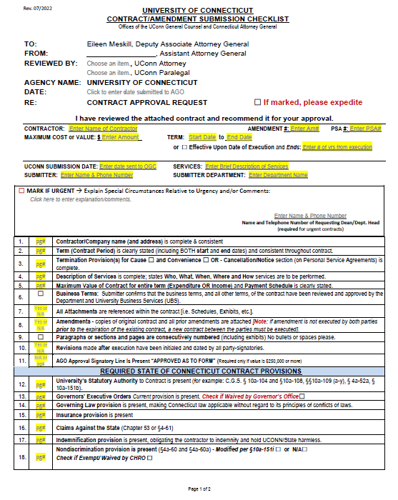
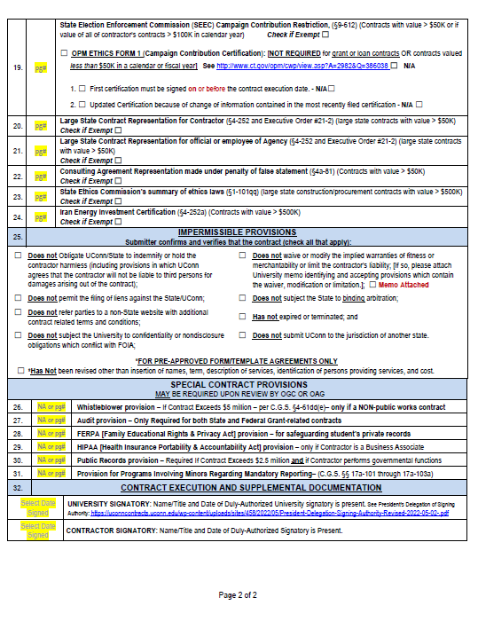
Contract Requirements

Slide 10
Non-Negotiable State Terms and Conditions
REQUIRED STATE OF CONNECTICUT CONTRACT PROVISIONS
Governors’ Executive Orders – Contracting has no authority to modify or waive executive order language without approval from Governor’s office.
Governing Law provision - making Connecticut law applicable without regard to its principles of conflicts of laws.
Claims Against the State – any claim against the State must go through Claims Commissioner first; cannot go straight to court.
Indemnification - obligating the contractor to indemnify and hold UCONN/State harmless.
Nondiscrimination – required by statute; no authority to modify without approval from the Commission on Human Rights and Opportunities.

Slide 11
Supplier vs. UConn Legal and Policy Terms & Conditions
IMPERMISSIBLE PROVISIONS
Obligates UConn/State to indemnify or hold the contractor harmless (including provisions in which UConn agrees that the contractor will not be liable to third persons for damages arising out of the contract)
Waives or modifies the implied warranties of fitness or merchantability or limit the contractor's liability
Refers parties to a non-State website with additional contract related terms and conditions
Submits UConn to the jurisdiction of another state
Supplier refusal to review State of Connecticut Terms and Conditions for low dollar contracts

Slide 12
Business Terms Incomplete/Not Finalized by Stakeholder and/or Procurement Staff
Vendor information not complete or accurate
Scope and description of services unclear
All business terms not reviewed and approved
Deal structure not complete (e.g., compensation, term of contract, maximum payable)
Conflicting policies and/or objectives between stakeholder department & other administrative departments
Lack of communication and/or coordination (e.g., other contracts and factors impacting contract)
Intellectual Property Rights not clearly stipulated

Slide 13
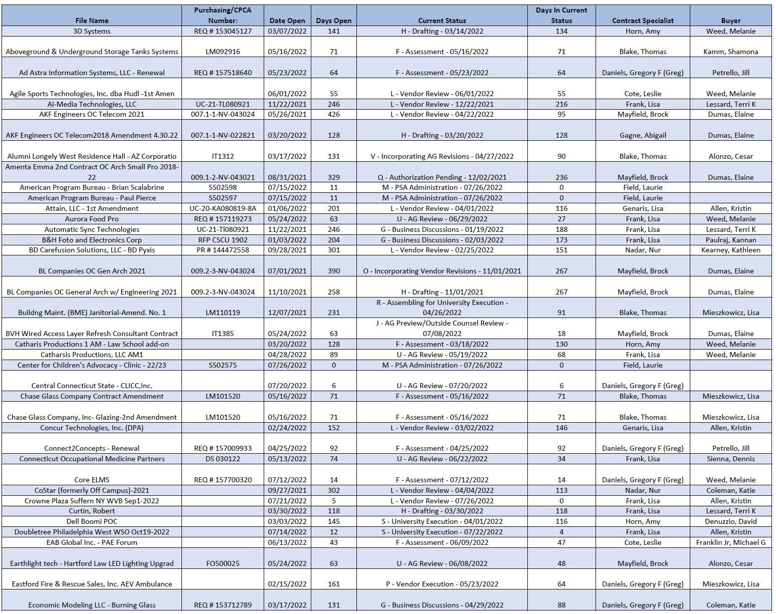
Enhance Data Reporting on Contracts
Raise awareness
Increase accuracy
Improve user friendliness
Add critical information
What is holding it up?
What are our options?
When will it be done?
Implement Contract Lifecycle Management technology

Slide 14
Future Contracting Organization
Director of Procurement Contracting and Compliance
Gregory F. Daniels
New Senior Contract Specialist (P-5) (IT)
Senior Contract Specialist (P-5)
Contract Specialist (P-4)
Vacant
(Business Services/Research)
Contract Specialist (P-4) (Research/PSA)
Contract Specialist
(P-4) (Business Services)
Contract Specialist (P-4) Vacant (IT)
Contract Specialist (P-4)
(Construction)
Contract Specialist (P-4)
(MRO/Facilities/ Construction)
New Senior Contract Specialist (P-5)
(Construction and MRO/Facilities)

Slide 15
Initial Process Improvement Actions
Ensure stakeholders and suppliers are aware of state contracting requirements, and involve Procurement and the Contract Specialist early in the process
Establish training & education for Procurement & Stakeholders regarding the full set of Contracting handoff requirements
Review when a contract is required vs. when a purchase order is sufficient
Review the approach for low value contracts
Identify and implement process improvements (e.g., utilize additional contract templates; remove unnecessary steps, etc.)
Evaluate & potentially implement a new Contract Lifecycle Management system

Slide 16
How Can You Help?
Understand Connecticut State requirements for supplier selection and contracting. Help ensure our potential suppliers do, too! Do this at the very beginning of the process not in the middle or near the end.
Involve Procurement & Contracting early in the process.
Be willing to actively exert influence on our suppliers to get them to agree with Connecticut state and other key requirements.
Be prepared to utilize another supplier if the primary supplier is unwilling to comply with the required terms and conditions.

Slide 17
Open Discussion

