Slide 1
University Senate Research Update
February 5, 2024

Slide 2
Agenda
Introductions and Overview
Dr. Pamir Alpay
Vice President for Research, Innovation and Entrepreneurship
SPS Updates and Response to the Senate Request
Michael Glasgow, Jr Associate Vice President for Research Sponsored Program Services
Research Integrity & Compliance Update
Michael Centola Associate Vice President for Research Integrity
OVPR Finances
Julie Schwager Executive Director for Operations Associate Vice President for Research Finance

Slide 3
Introduction and Updates
Research Awards and Expenditures

Slide 4
OVPR by the Numbers
invention disclosures
staff
Patents
350+
946
99
in portfolio
In FY 2023
proposals processed
Research Expenditures
active awards
TIP Companies
2,078
$322M
1800+
56
in FY2023
in FY2023

Slide 5
Proposal Data
1,647
Proposals submitted FY 23, Storrs
SPS Update and Response to Pre-Award Recommendations
of these
86%
SPS reviewed and submitted to sponsor in 3 days or less.

Slide 6
SPS Steps Taken to Strengthen Communication and Support
SPS Pre-Award help line is live to provide urgent assistance to investigators when their team member is not immediately available.
Email help line
spshelp@uconn.edu
Phone help line
(860)486-1023
Feedback and discussion with units has been strengthened:
Ad hoc discussions with groups of administrators at UConn and UConn Health; Transitioning to standing research administration process improvement team
NEW Investigator group to provide feedback and identify areas for improvement in research administration
Longevity and relevance of Sponsored Programs Administrator (SPA) meetings
The following groups serve an advisory function and offer a platform for discussion:
President’s Research Advisory Council
Research Deans Council

Slide 7
SPS Steps Taken to Expedite Processing of Small Proposals
Proposals less than $100,000
230
submitted in FY23
Limited signature authority has been delegated to SPS pre-award specialists.
of these
112
had firm deadlines.
Pre-award specialists can now submit approximately 50% of their portfolios.
Previously, there were only two signatories in SPS, the director and the assistant director of pre-award.
of these
93%
were administratively reviewed within 3 days or less.

Slide 8
SPS Steps Taken to Streamline Submission Process
01
02
03
Piloting a new proposal budget template that will help staff prepare budgets and reduce budgetary review.
Implemented tools and guidance for budgeting cost share, which have been presented at the SPA and posted on the SPS website. Guidance includes examples for meeting mandatory cost share requirements using cash and in-kind costs.
Department Head signatures no longer required to cost share the mandatory 1% effort.

Slide 9
What’s Happening in Other Areas to Improve Service?
Award Set-Up Team created
Under Development
Contracts
SPS has created an award set-up team focused solely on award acceptance and account creation. Allows post award to focus on award administration and billing.
Contracts unit split into 2 teams, federal and non-federal, to focus expertise and reduce turn around times
Web-based access to research account financial information nearing completion.
SPS beginning implementing JIRA (a ticketing system used by a variety of departments on campus) in Post Award. Will provide PIs and unit administrators with greater visibility into transactions such as NCE requests, cost transfers, and re-budgeting requests.

Slide 10
Research Integrity and Compliance Update
Internal IRB
~1500 active studies
~1600 submissions/ year
~ 16 studies are FDA-regulated
IBC Submission Data
215 UConn Labs with IBC Registrations
215 Registrations & Amendments Reviewed in 2023
341 HuskySMS Submissions Requiring Review
BRANY IRB
Began utilizing for certain studies in June 2023
~ 50 studies currently under BRANY IRB oversight
IACUC
~472 submissions
~200 active protocols
COI
1,653 Financial Disclosures
185 Significant Financial Disclosures
66 Active Management Plans

Slide 11
Research Integrity and Compliance Update
Average Number of Weeks for IRB Turn Around
Number of Financial Disclosures Submitted

Slide 12
Research Support and Expenses at a Glance
Expenses
85% of OVPR Operating Funds come from IDCs
15% from central funding
Research Administration (personnel for Research Finance, Sponsored Programs, Research Integrity & Compliance, Research Development, Technology Commercialization Services)
Institutional Research Support (Centers & Institutes, Shared facilities, Internal seed funding, Cost-sharing, etc.)
IDC distribution (10/10/10)
Support

Slide 13
FY 25 Preliminary Budget
Research Budget Categories
Institutional Research Support (net of revenues)
FY25 Budget
Centers and Institutes
12,509,814
21%
IDC 10/10/10 Distributions
13,284,595
23%
Other Commitments
4,600,000
8%
Internal Awards
3,500,000
6%
Startup Support
4,000,000
7%
Animal Care Services
1,782,284
3%
COR
2
E
1,265,310
2%
Faculty Shared Services
1,355,774
2%
Administration
15,967,743
27%
Total Expenses
58,265,520
100%
Projected IDC Recoveries 52,250,000
* Other commitments include bridge funding, Career Awardee support, small grant F&A assistance program, equipment (new, replacement, and repair), faculty summer salary support (1 week),…

Slide 14
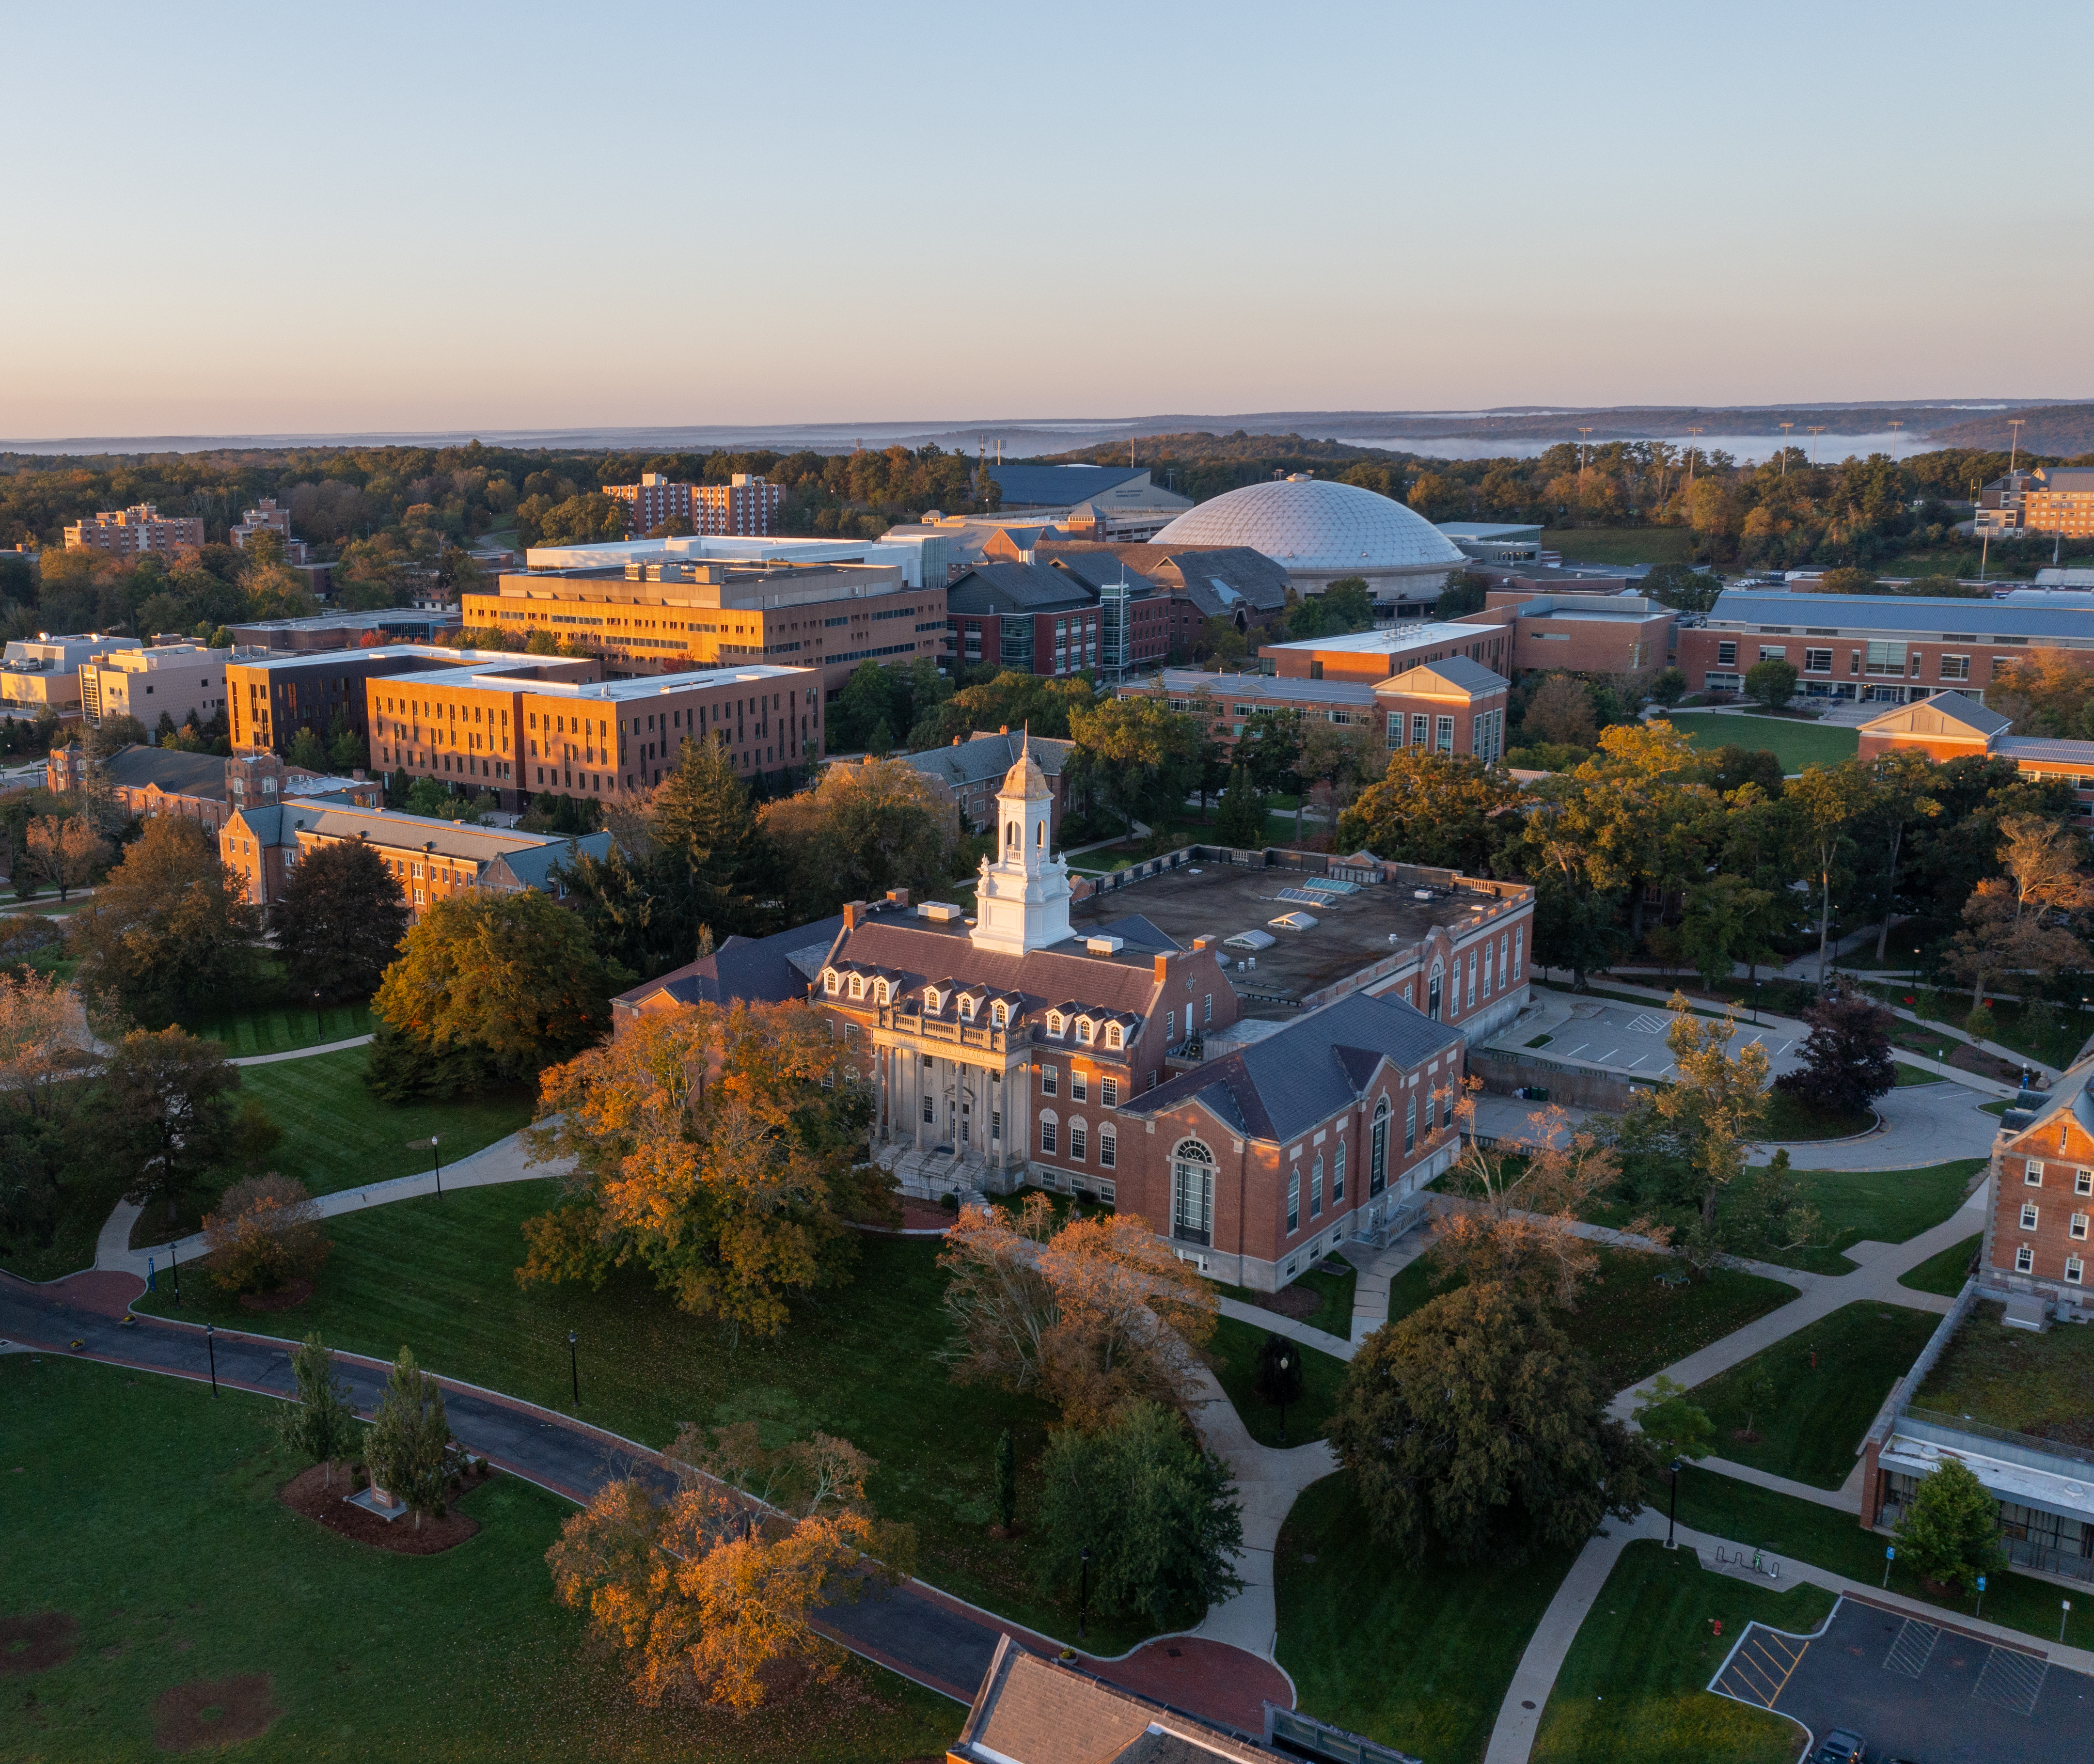
Thank you

